Slide 1
Episode Workbooks
Module 3: EQIP Episodes
Notes:
Welcome back to the EQIP curriculum! Today we will be focusing on the episode workbooks within the Episode Quality Improvement Program.

Slide 2
What is an Episode Workbook?
The episode workbook is an excel document that displays all relevant information relating to a particular episode within the EQIP Program
Episode workbooks are composed of:
Episode Definitions
Trigger Codes
Relevant Codes
Associations

Slide 3
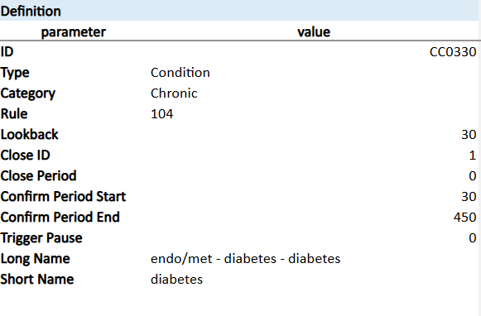
Episode Definitions
Episode Definitions serve as an overview of the condition or procedure episode
Episode type, category, and length
Notes:
The Episode definition is an overview of the condition/ procedure that aligns with the workbook. Within the definition tab you will find the ID which is how PACES identifies this episode. The type represents what kind of episode type it falls under which will either be condition or procedure. The category is typically either chronic or acute. The lookback represents the number of days before the initial trigger that is counted within the episode. The close period is the number of days following the trigger event/date that will be included within the episode. These are the fields that are most important to understand and review for all episodes that your entity will participate in

Slide 4
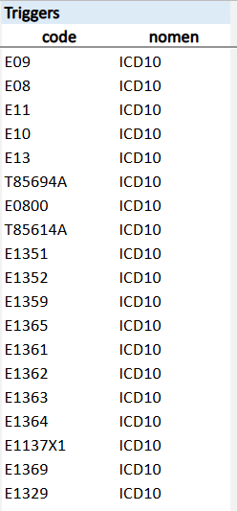
Trigger Codes
Episode trigger codes are the specific ICD-10, CPT, or HCPCS codes that will initiate the start of a Clinical Episode.
Notes:
The amount of trigger codes can range depending on the episode. The trigger codes represent what needs to be billed for this episode to be triggered or started . This is also known as the code that opens the episode.

Slide 5
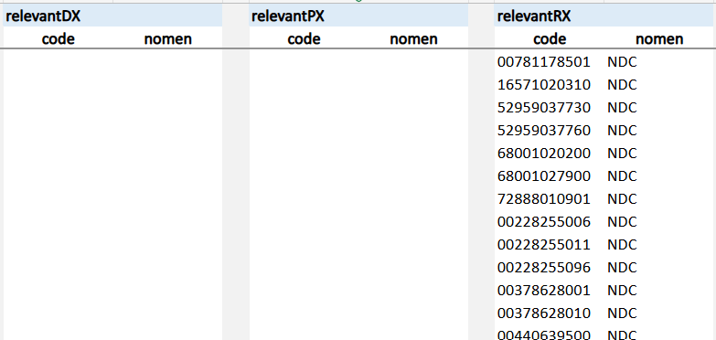
Relevant Codes
Relevant codes are clinically associated with the condition or treatment of the Episode.
EQIP Episodes may include the following relevant codes:
Relevant DX
Relevant PX
Relevant RX

Slide 6
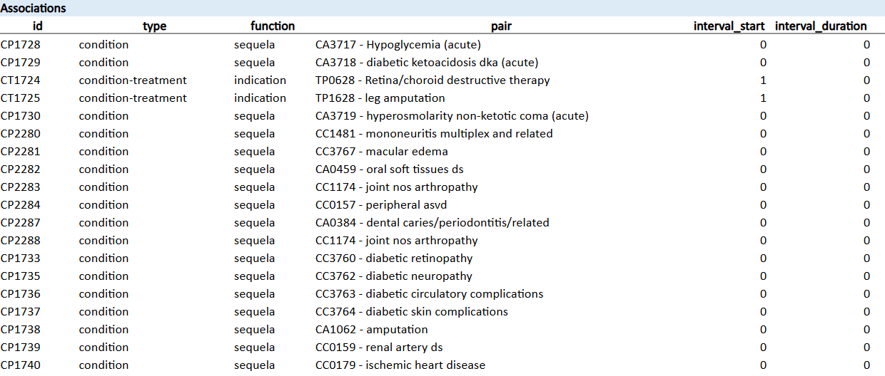
Associations
Associations are considered episodes that are paired together because of their clinical relevance to one another
Types of Associations
Many to one
One to Many
Conditions can be associated with other conditions
Procedures can be associated with procedures
Conditions can be associated with procedures
Notes:
-Describe episodes that are “paired” due to clinical relevance. There can be many to one and one to many associations. Conditions can be associated with one another; procedures can be associated with one another; and conditions can be associated with procedures.

Slide 7
Want to Learn More?
Visit the full EQIP Curriculum to explore comprehensive learning modules and deepen your understanding of Maryland’s Episode Quality Improvement Program (EQIP).
Notes:
We hope this video helped you understand the episode workbooks a bit more! And if you want to learn more about EQIP, visit the full EQIP curriculum to explore comprehensive learning modules to deepen your understanding of Maryland's Episode Quality improvement program.

