Slide 1
Episode Playbook
Module 3: EQIP Episodes
Notes:
Welcome to the EQIP Curriculum! In this video, I will introduce the EQIP Episode Playbook.

Slide 2
What is the EQIP Episode Playbook?
The EQIP Episode Playbook provides an overview of each EQIP Episode. A playbook for each Performance Year will be created to provide participants with Episode definitions and construction codes.
Notes:
What is the EQIP Episode Playbook? The EQIP Episode Playbook provides an overview of each EQIP Episode and construction codes. A playbook for each Performance Year will be created to provide participants with Episode definitions and construction codes.

Slide 3
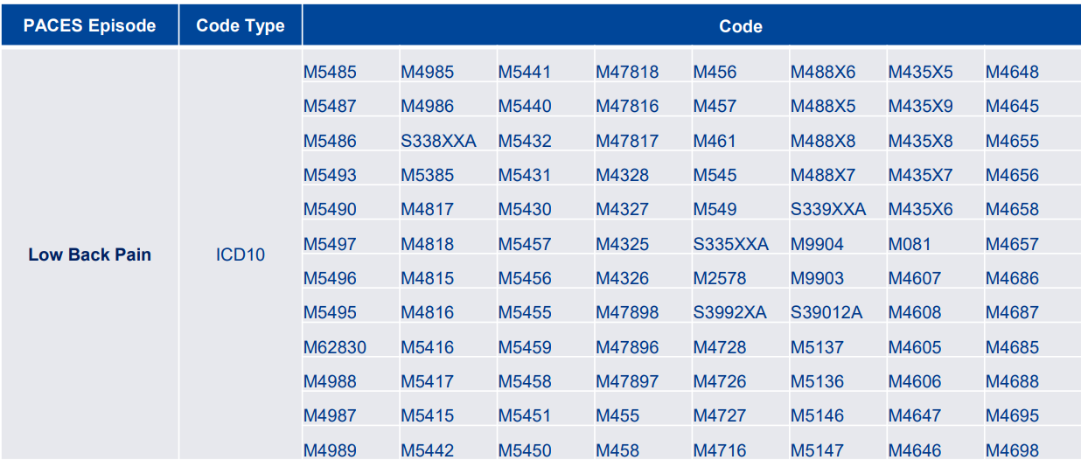
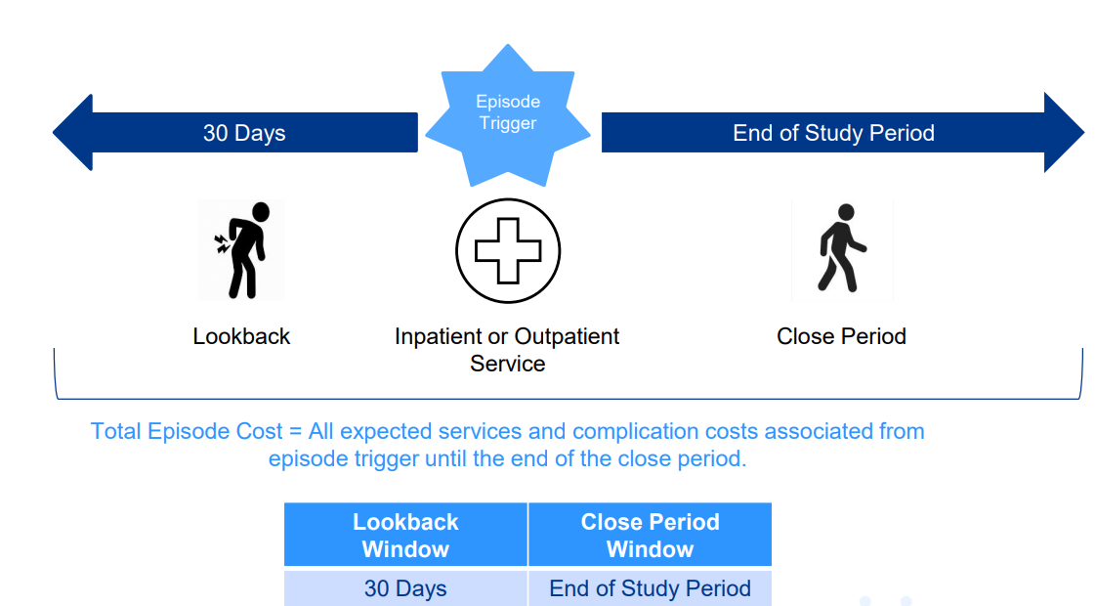
Key Components
Episode Triggers
An index hospital stay or procedure during which the initial care was performed.
Defined by a Current Procedural Terminology (CPT) or Healthcare Common Procedure Coding System (HCPCS) code for procedural episodes or International Classification of Diseases-Tenth Revision-Clinical Modification (ICD-10-CM) diagnosis code for acute episodes.
Episode Length
Lookback period: The time period prior to the trigger in which all costs related to the trigger will be considered.
Close period: The time period following the triggering event, during which all costs related to the trigger will be considered.
Notes:
The Episode Playbook contains a lot of important information. I am going to highlight two key components available in the playbook. The first are episode trigger codes. Trigger codes are the CPT, HCPCS, or ICD-10 codes that initiate the start of an EQIP Episode. For example, the trigger codes for low back pain are listed on the screen. These codes will trigger a low back pain episode under EQIP. The second component is the episode length. The episode length is defined by two periods. The first is the look back period. The lookback period is the time prior to the trigger in which all costs related to the trigger will be considered. The second period is the close period. The close period is the time following the triggering event, during which all costs related to the trigger will be considered. For example, the lookback period for low back pain is 30 days prior to the trigger and the close period is until the end of the performance year. For additional information, please visit the full Excel workbooks for the PACES episodes that are linked throughout the playbook.

Slide 4
Want to Learn More?
Visit the full EQIP Curriculum to explore comprehensive learning modules and deepen your understanding of Maryland’s Episode Quality Improvement Program (EQIP).
Notes:
Do you want to learn more about EQIP? Visit the full EQIP Curriculum to explore comprehensive learning modules and deepen your understanding of Maryland’s Episode Quality Improvement Program (EQIP).

