Slide 1
CRISP MD General Onboarding
10480 Little Patuxent Parkway, Suite 800
Columbia, MD 21044
877.952.7477 | info@crisphealth.org
www.crisphealth.org

Slide 2
Agenda
CRISP HIE Background
Onboarding Process
Overview of Key Tools
InContext/Clinical Information Tool
Population Explorer Tool & CEND
Consent Tool
Referral Tool
Reporting Services Tools (CRISP Reporting Services)

Slide 3
Background on CRISP HIE

Slide 4
What is CRISP?
Chesapeake Regional Information System for Our Patients
State-Designated Health Information Exchange
Shared Infrastructure between MD, DC, WV, CT, AK
Mission: We will support the healthcare community of MD and our region to appropriately and securely share health information in order to facilitate care, reduce costs, and improve health outcomes.
Vision: To advance health and wellness by deploying health information technology solutions adopted through cooperation and collaboration.

Slide 5
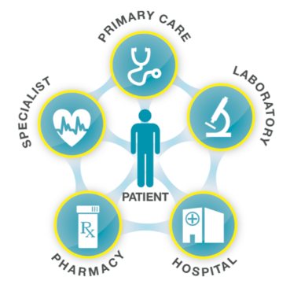
Importance of Health Information Exchange (HIE)
Help doctors, hospitals, and other healthcare professionals deliver faster, better care by promoting medical data sharing across the region
Assist the State in the evaluation of public health interventions and health equity
Coordinate healthcare between different providers, ensuring a more cohesive healthcare experience for patients
May lower patient healthcare costs by reducing repeated tests

Slide 6
What Does CRISP Do?
Point of Care: InContext & Clinical Information Service Information
Search for your patients’ prior health records (labs, radiology reports, etc.)
Determine other members of your patient’s care team
View external records in a SMART on FHIR app inside your EHR
Care Coordination: Event Notifications (CEND)
Be notified when your patient is hospitalized in any regional hospital
Enhance workflows across multiple care settings and teams
Population Health Reports: CRISP Reporting Services (CRS)
Using claims, public health, and clinical data to design dashboards and measure interventions
Program Administration
Making policy discussions more transparent and informed
Disseminating evidence-based best practices and technology
Public Health & Health Data Utility
Deploying services in partnership with health officials
Providing information and services to state and local health departments

Slide 7
Onboarding Process

Slide 8
Onboarding Process
Getting Started with CRISP
Panel Processor
HIE Admin Tool
CRISP Portal

Slide 9
Getting Started with CRISP
Forms for organizations to eSign – more info can be found on the CRISP Website
Participation Agreement (PA)
Notice of Privacy Practices (NPP)
Substance Abuse Attestation (SUD)
LabCorp & Quest Feed
Patient Panel Submission
Submitting a panel
Panels are excel spreadsheets that are pulled from healthcare offices’ EMRs including patients from the last 18 months.
Most panels must be updated at least every two years to avoid expiration.
They can be submitted through the Panel Processor Application.

Slide 10
Panel Processor
The Panel Processor application allows users to upload panels for various services, like the CRISP Event Notification Delivery (CEND) Solution, into the HIE.
There are two tabs within the Panel Processor Application – ‘Upload File’ and ‘Upload History’.
The ‘Upload File’ tab is where users can submit a panel following the process prompts.
Users can view the results of Previous successful and unsuccessful upload attempts in the ‘Upload History’ tab
Users must select a template to submit a panel through the Panel Processor.
Templates are defined file formats with specific column fields and field data types. Each service using the Panel Processor will have a unique template that can be downloaded in the Processor.

Slide 11
Panel Processor
To submit a panel through the Panel Processor user must:
(1) Select the template of the service your panel will be used for.
For CEND Panel Submissions, Select the panel you want to update. The Panel Processor will prompt you to select a panel by name and source code. A source code is a unique set of letters used within the HIE to identify a panel.
(2) Navigate to the ‘Upload File’ step by clicking ‘Next’, ‘Upload File’, or directly on the number two icon.
(3) Upload the completed file by dragging or clicking the grey box on the screen.
(4) Click ‘Submit’ to load the panel to the processor.
(5) The processor will preform a quick initial check to validate the file type and file size.
File type must be csv, txt, or tsv. File size can be no larger than 100 MB

Slide 12
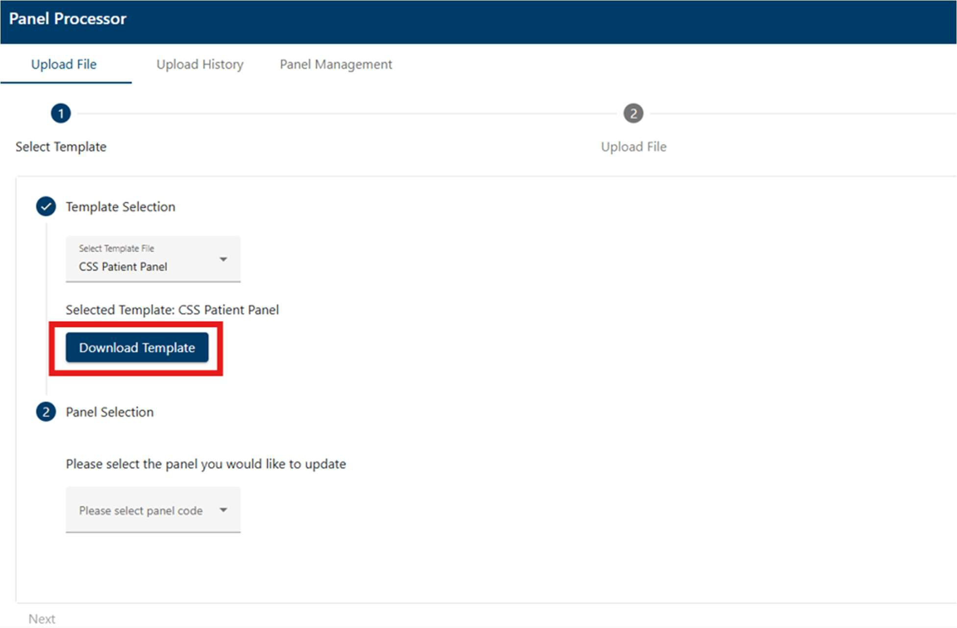
Panel Processor

Slide 13
HIE Admin Tool
CRISP Participants are required to assign the HIE Administrator Role to one or more users at their organization.
The Health Information Exchange (HIE) Admin Tool enables HIE Administrators to manage CRISP Portal accounts within their organization. The tool allows users to:
Create Users
Reactivate Suspended Users
Recreate Deactivated Users
Audit Users
Deactivate users who leave the organization/no longer require access
View Account Services
Provision Services to Users

Slide 14
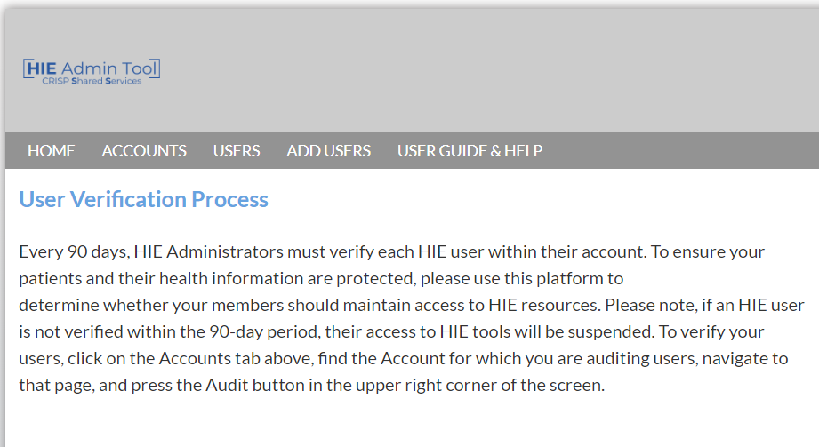
HIE Administrator Set Up
HIE Administrators will receive a welcome email with instructions on how to activate their account. This includes
creating an account and setting up two-factor authentication.
After the account is set up, the admin can begin to verify users by selecting the “Accounts” tab.

Slide 15
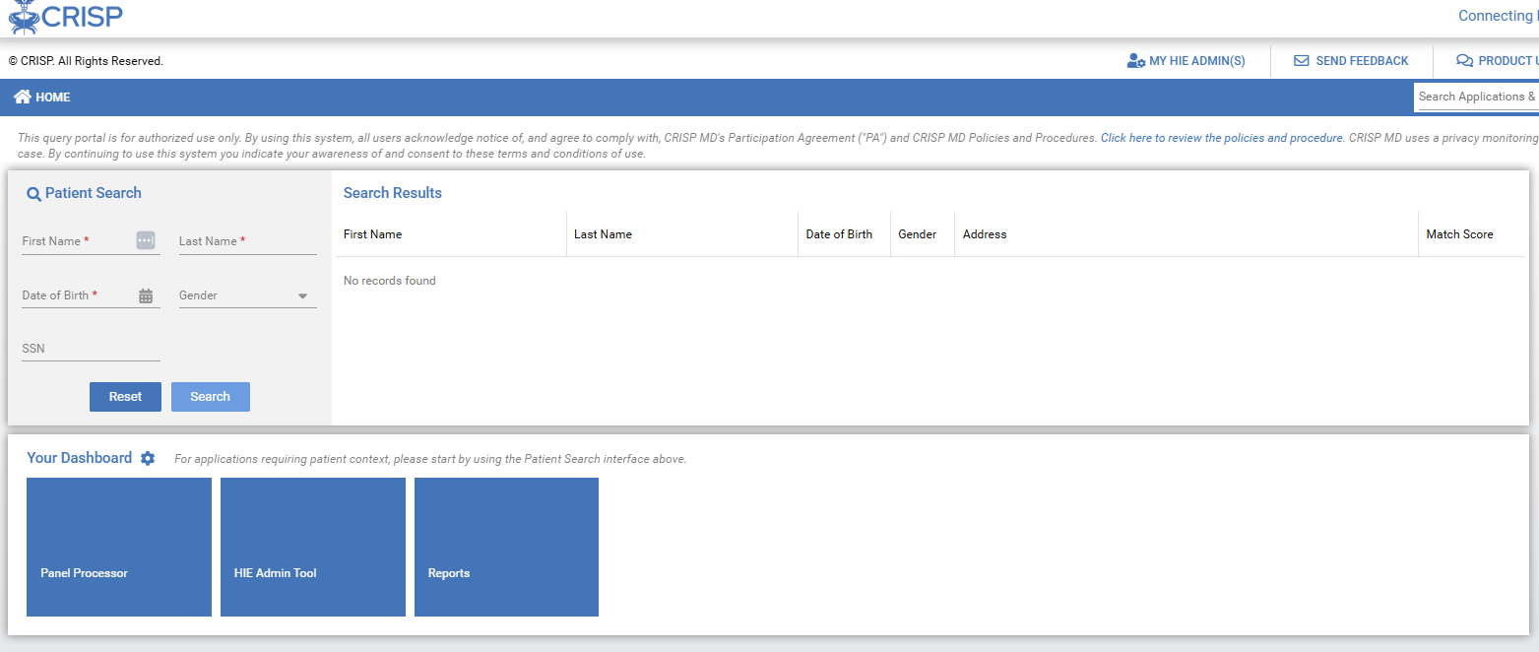
CRISP Portal
The CRISP Portal allows users to access the CRISP applications used by their organization.
Users can also search for a specific patient using the Patient Search menu.
Most CRISP Apps can be found under Your Dashboard.
Note: Some applications can only be accessed when searching a patient (i.e., Clinical Information).

Slide 16
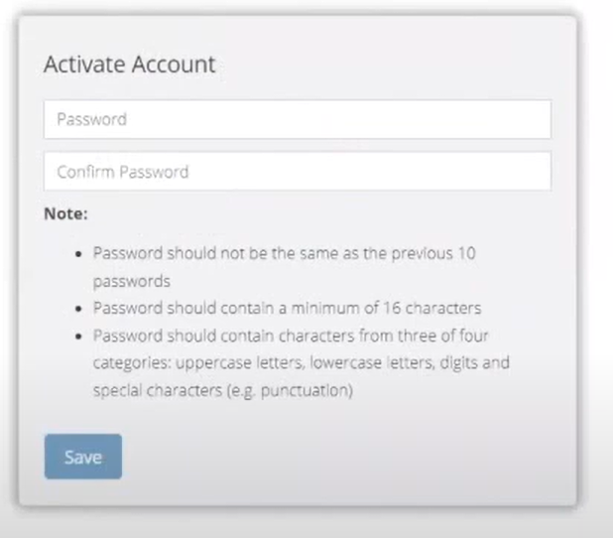
CRISP Portal Set Up
New users will receive an email from ‘donotreply@hmetrix.com’ containing instructions on how to activate their portal account.
CRISP places an emphasis on security and requires that all users set up two-factor authentication for their portal account. CRISP accepts most 2FA applications including:
Twilio Authy Application
Security Key (i.e., YubiKey)
Other Authentication Applications (i.e., Google Authenticator, Microsoft Authenticator, Duo)

Slide 17
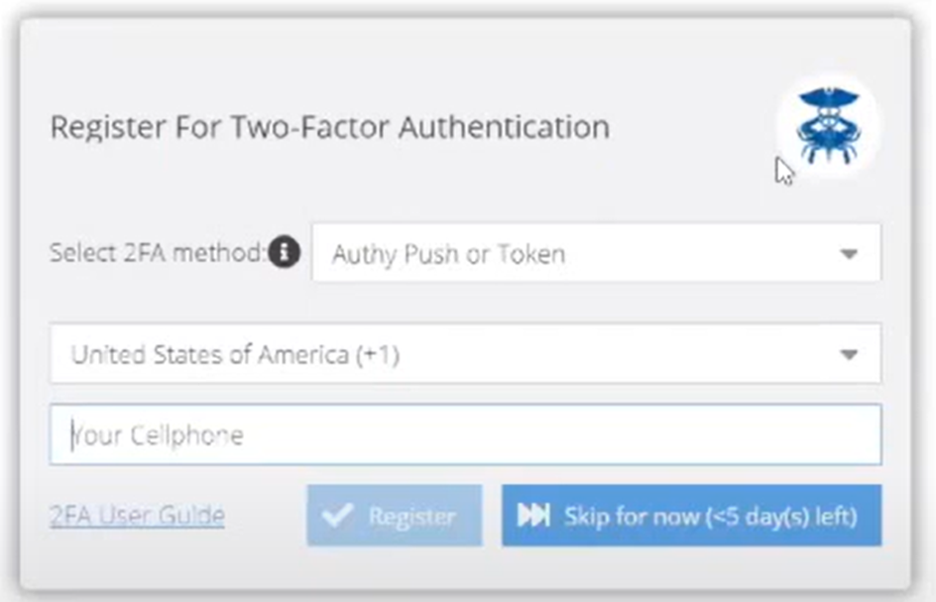
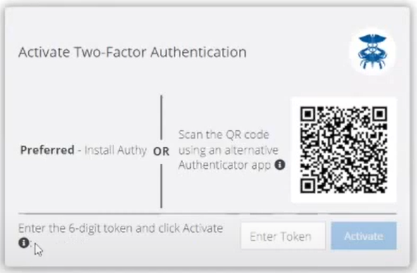
CRISP Portal Set Up cont.
You will receive a text after you enter your phone number with a link to download the Twilio Authy App.
To use another Authenticator, enter your phone number and scan the QR Code that appears using your Authenticator app.
Once a password and two-factor authentication are set up, users can log into the portal here: https://portal.crisphealth.org/
17

Slide 18
Overview of Key Tools

Slide 19
Key Tools
InContext/Clinical Information Service (Slides 21-25)
Population Explorer and CSS Event Notification Delivery (CEND) (Slides 26-45)
Consent Tool (Slides 46-55)
Referral Tool (Slides 56-59)
CRISP Reporting Services (CRS) (Slides 60-64)

Slide 20
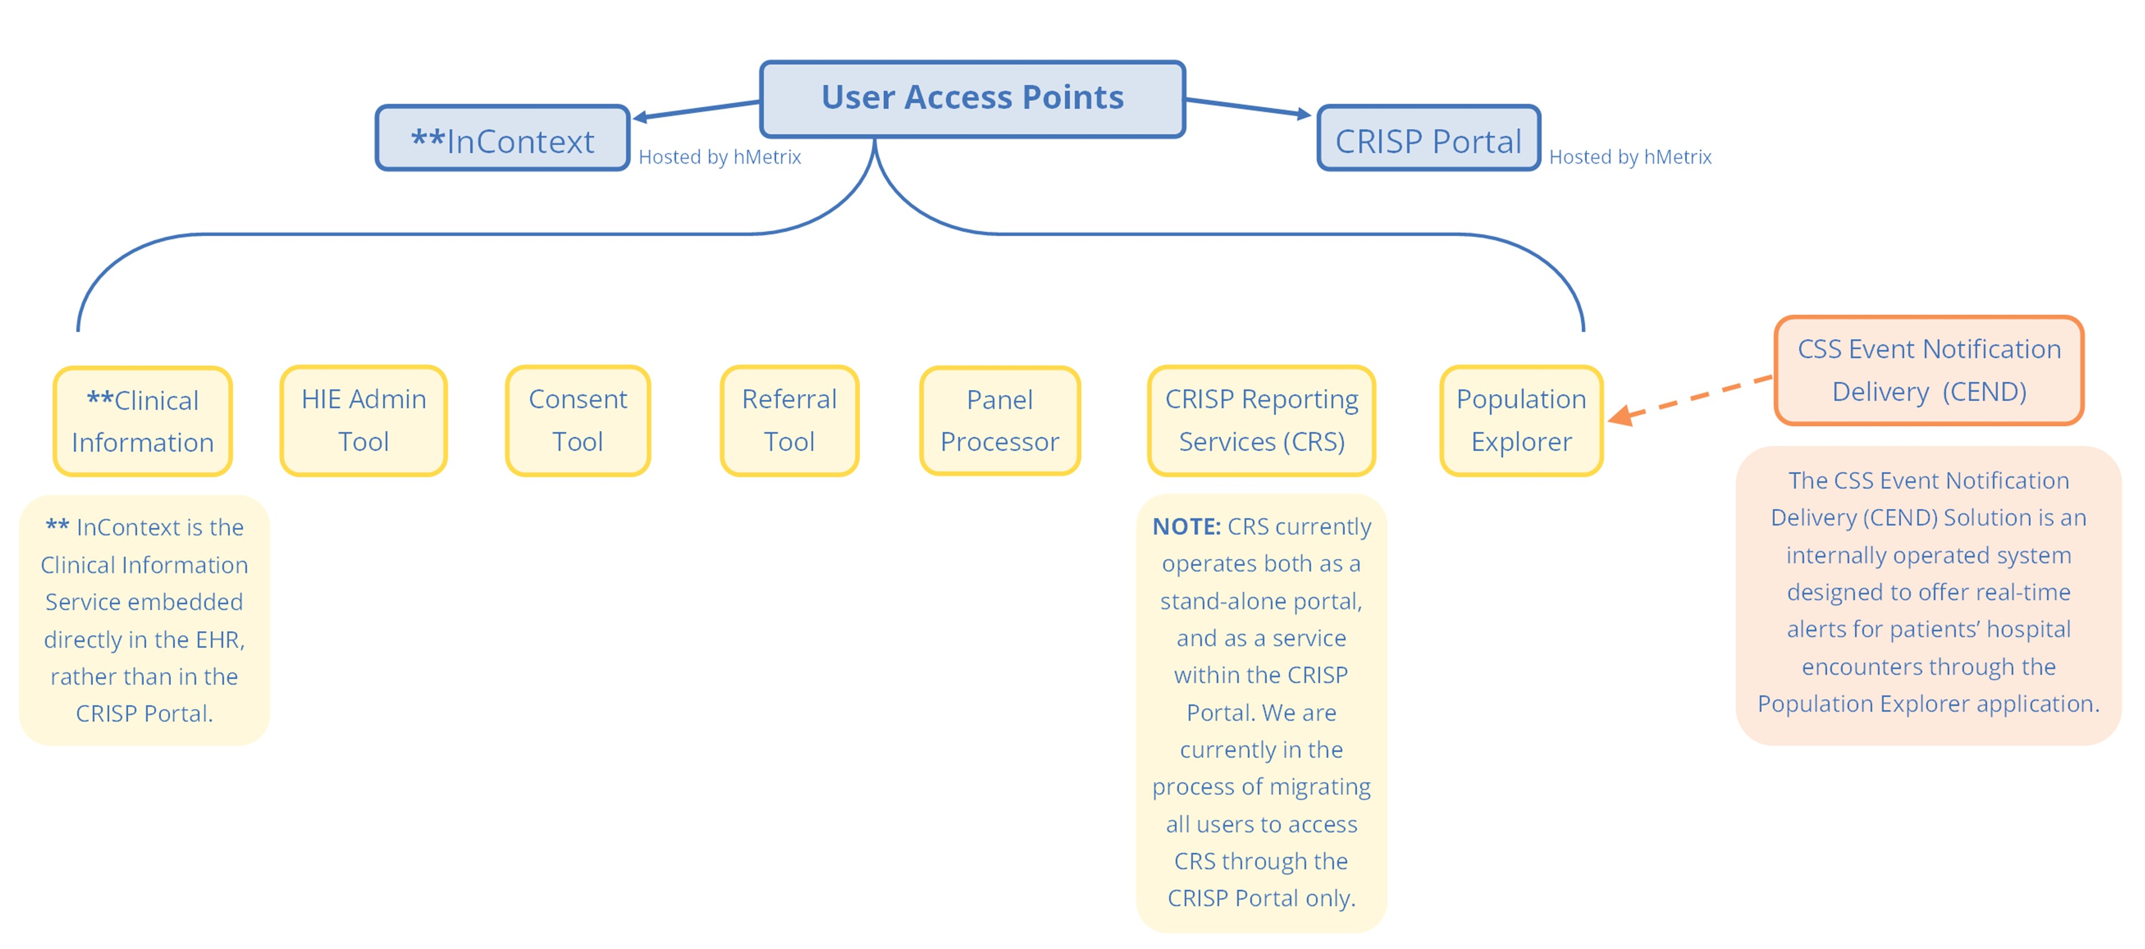
Key Tools cont.

Slide 21
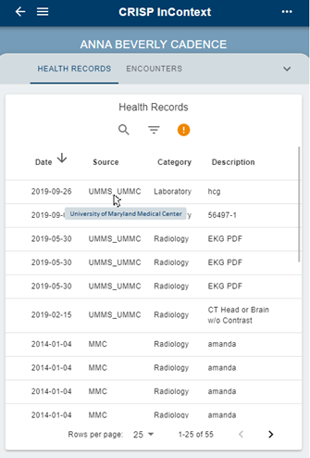
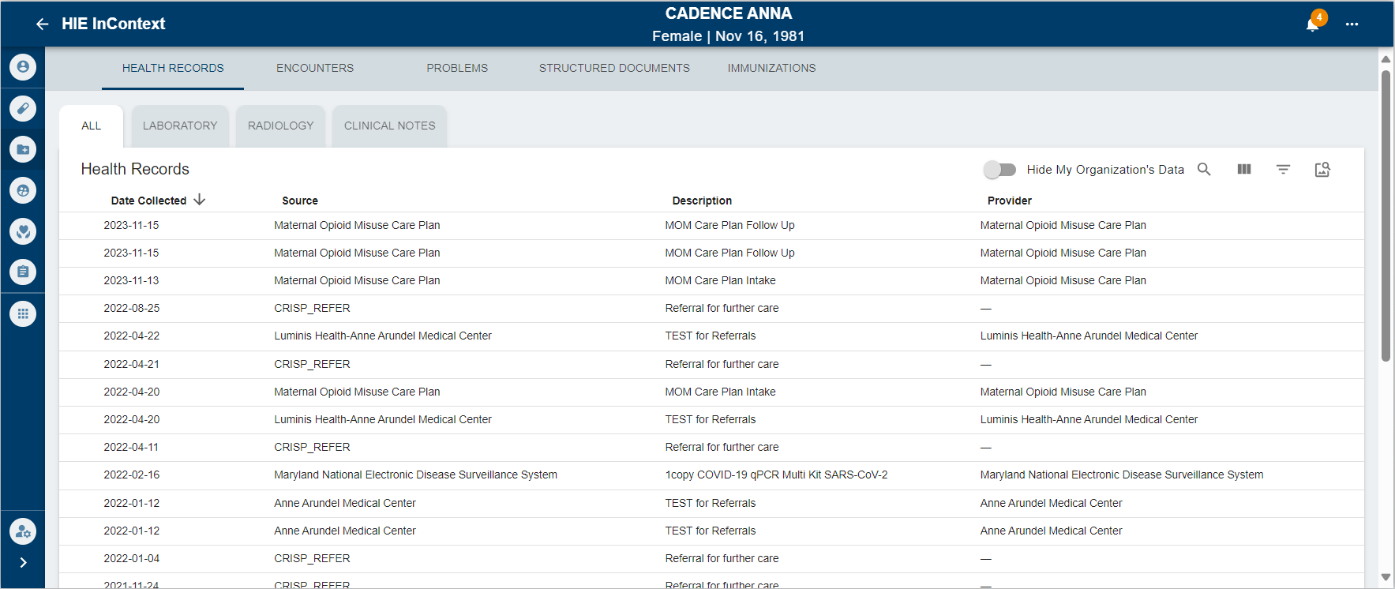
InContext/Clinical Information
CRISP InContext delivers real-time data from the CRISP HIE directly to healthcare provider workflows through their electronic healthcare record (EHR) system.
InContext is an effective tool when a user needs information not found within their EMR.
InContext can display in either of these two views.

Slide 22
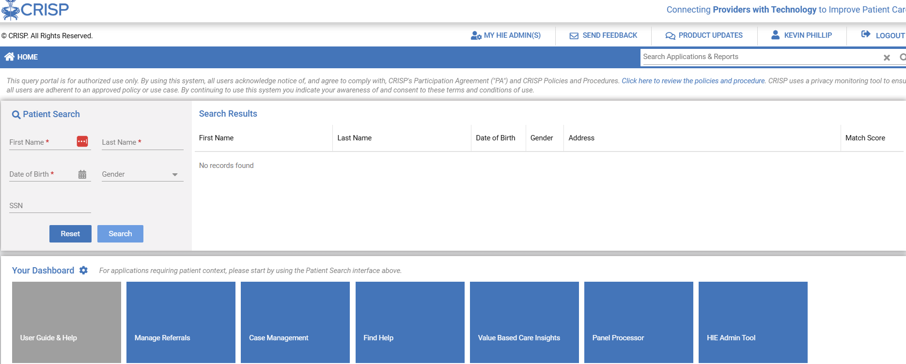
Accessing InContext
When viewing a patient’s EMR within the EHR, users can launch the InContext App by clicking the CRISP icon. The following EHR’s are integrated with CRISP InContext:
If your EHR is not connected with InContext, you can access the App within a secure web-based site called CRISP Portal.
To access the CRISP Portal, visit https://portal.crisphealth.org
Within the CRISP Portal, InContext is called Clinical Information Service.

Slide 23
InContext Tabs and Subtabs
Patient Information
Priority Alerts
Medication Management
PDMP
PDMP Advisories
Reported Medications
Clinical Data
Health Records
Encounters
Problems
Structured Documents (CCDAs)
Immunization
Care Coordination
Care Team
Care Alerts
Referral History
Advance Directives
Social Determinants
Assessment
Conditions
Claims Data
Apps from CRISP Portal

Slide 24
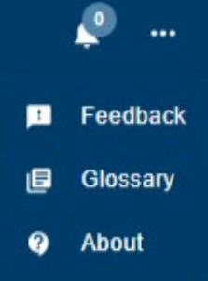
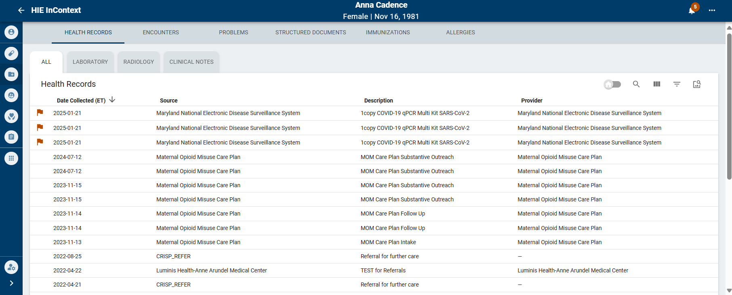
InContext Features cont.
Priority alerts are found here. They include clinical alerts and infectious control alerts.
Feedback: send non-PHI feedback to our development staff
Glossary: definitions of terms used in the application About: application version & release notes
To toggle the InContext side bar, click this arrow.

Slide 25
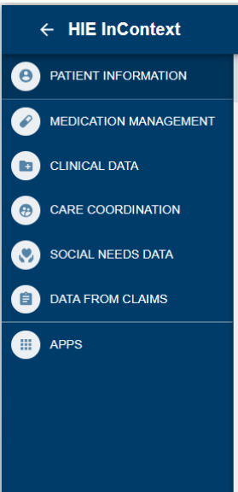
InContext Features cont.
The apps widget allows users to launch CRISP applications via the CRISP Portal. Authorized users can launch the following apps:
Consent Tool
Referral Tool
MyDirectives DC (this is available only to DC-licensed providers)

Slide 26
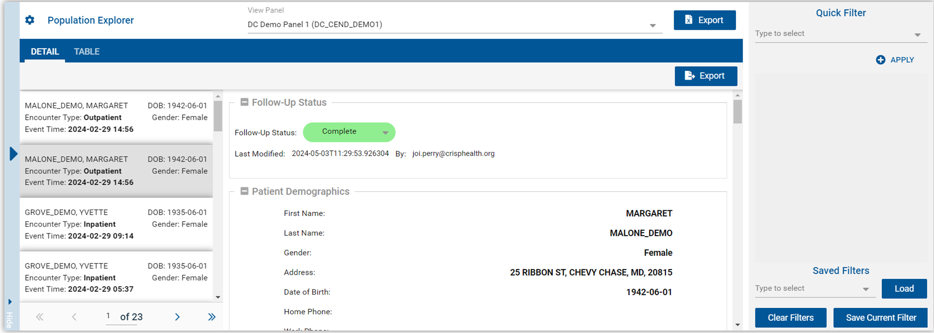
CEND & Population Explorer Tool
The CRISP Event Notification Delivery (CEND) service offers real-time alerts for patients’ hospital encounters.
Population explorer integrates CEND into the CRISP Portal, providing an interface for clinicians and care teams to view patient encounters.

Slide 27
Population Explorer Tool & CEND
Key Features and Functionalities
Patient Record/Other App Launching
Expanded View
Follow Up Status
Patient Demographics
Selected Encounter Details
Diagnosis Details
Encounter History
Filters
Data Exports

Slide 28
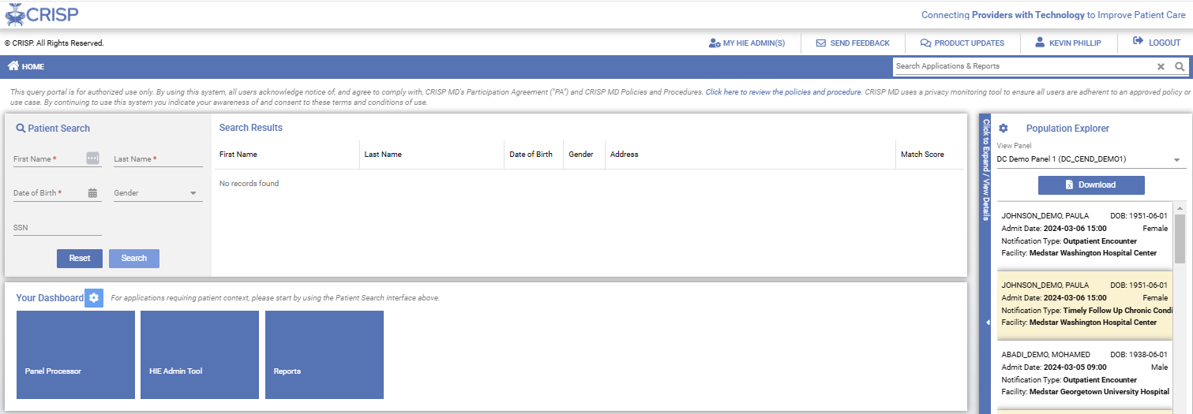
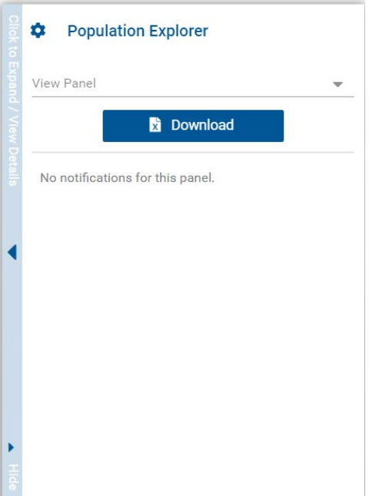
Accessing Population Explorer
To access Population Explorer, Log into the CRISP Portal. On the right-hand side of the screen, you will see the Population Explorer pane.
To choose a panel, use the drop-down menu labeled “View Panel” at the top of the pane. After selecting a panel from the list of your available panel, the pane will display event notification for that panel.

Slide 29
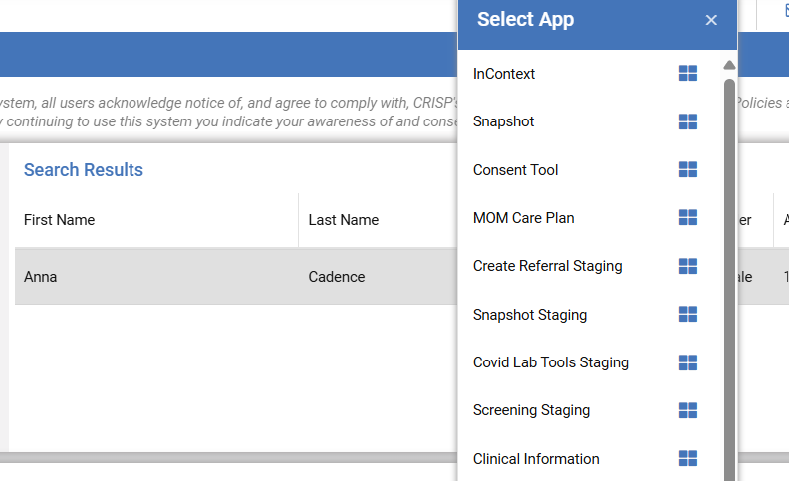
Patient Record/Other App Launching
You can link back to a patient’s clinical information in the portal by right clicking on that patient within the expanded or collapsed view.
29

Slide 30
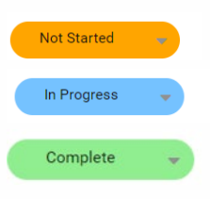
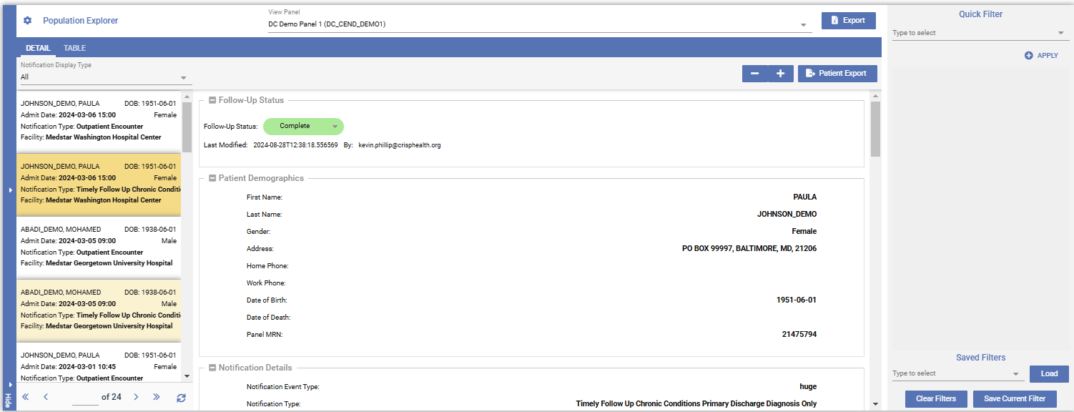
Expanded View and Follow Up Status
To toggle between expanded or collapsed view, use the arrows on the side. In the expanded view, users can see more detailed information including
demographics, encounter details, and follow-up status.
The follow-up status drop-down allows
users to provide updates reflecting whether a notification has been resolved.

Slide 31
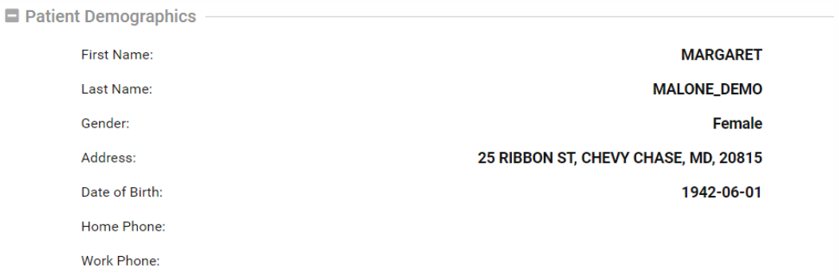
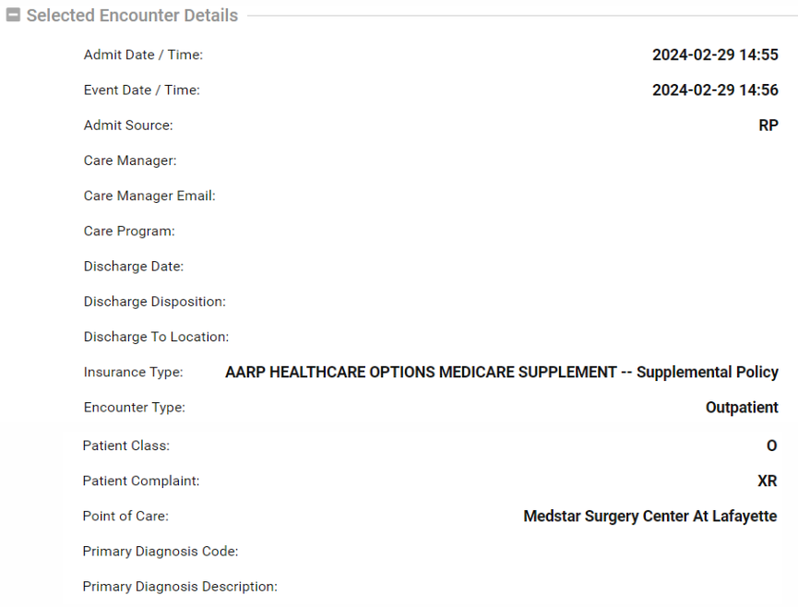
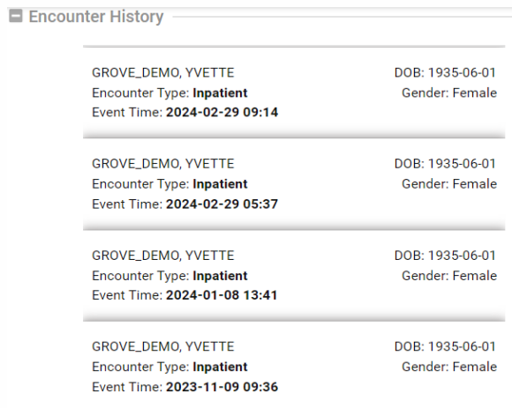
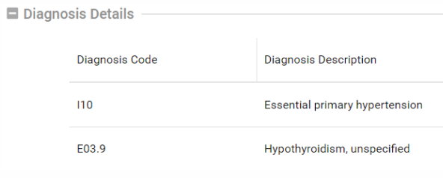
Expanded View cont.
In Population Explorer, all related patient events are consolidated into a single encounter line item.
Under Encounter History, users can view encounter history from the last six months.

Slide 32
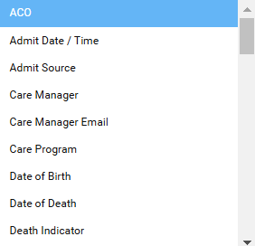
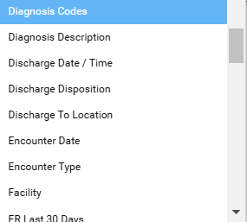
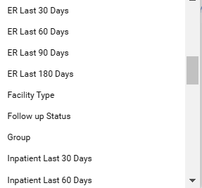
Filters
Users can create, manage, save, and apply filters to the notification list using the “Quick Filter” bar on the right-hand side of the screen. Multiple filters can be applied at one time. The available filters are below.
View a full filter list with definitions on the CRISP Website CEND Webpage, or by clicking here.

Slide 33
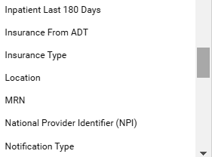
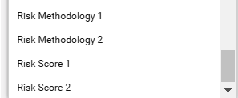
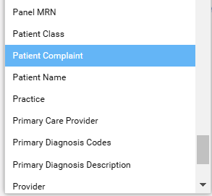
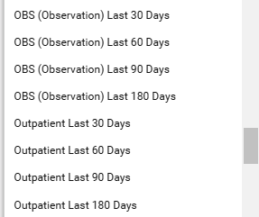
Filters (Cont.)

Slide 34
Advanced Panel Builder (APB)
The APB allows users to flexibly create much more complex criteria definitions for filtering patient populations by combing panels and applying Boolean logic operators to any of the data elements available in Population Explorer.
Advanced Panels can be created using either one or multiple panels to which a user has access.
Useful in situations where the Quick Filter functionality does not offer sufficient granularity for targeting a desired set of beneficiaries or events.
Must first be enabled before use.

Slide 35
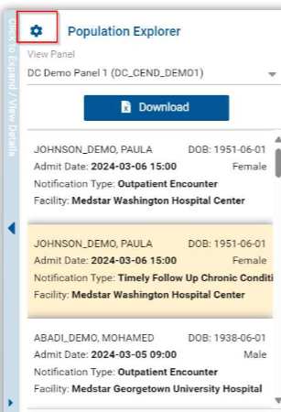
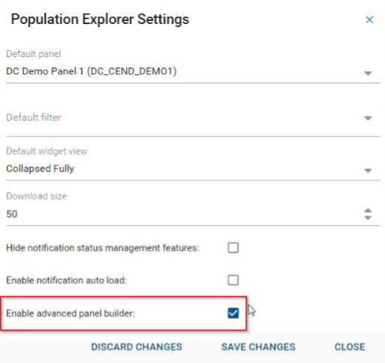
Enabling & Accessing APB
Expanded View
Default View
Upon first use, navigate to settings menu.
Select “Enable Advanced Panel Builder” and save changes.

Slide 36
Enabling & Accessing APB
Once enabled, APB is accessible using the “Configure Advanced Panels” button in the upper right corner of the Detail View Pane.

Slide 37
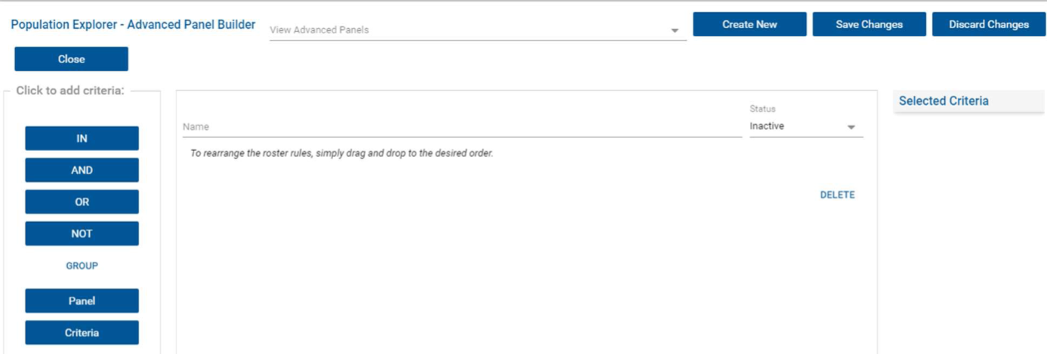
APB Interface
Upon opening the Advanced Panel Builder, you will be presented with a new APB template, as shown below.
To edit an existing advanced panel, select from the ‘View Advanced Panels’ dropdown at the top of the screen.

Slide 38
APB Interface cont.
To create a new panel, enter the name for your advanced panel and hit ‘Save Changes’. You can then add criteria.
To discard any unsaved changes on the currently selected panel, hit the ‘Discard Changes’ button.

Slide 39
APB Interface cont.
To open a blank APB template after editing or creating a panel, simply click the ‘Create New’ button.
Use the Status dropdown in the creation dialogue interface to set the status of an advanced panel as “Active” or “Inactive”
NOTE: Only Active advanced panels will appear in dropdowns throughout the Population Explorer. Set a panel to Inactive if you do not want it to appear in the interface, but do not want to delete it entirely.

Slide 40
APB Interface – Building Advanced Panels
The buttons along the left-hand side of the interface allow you to add panels, criteria, and logical operators to the Advance Panel.
Click the ‘Panel’ button first to open a selection interface which allows you to choose one or more panels as the basis for the advanced panel.
Any beneficiaries included on any of the selected panels will be evaluated for inclusion in the advanced panel.

Slide 41
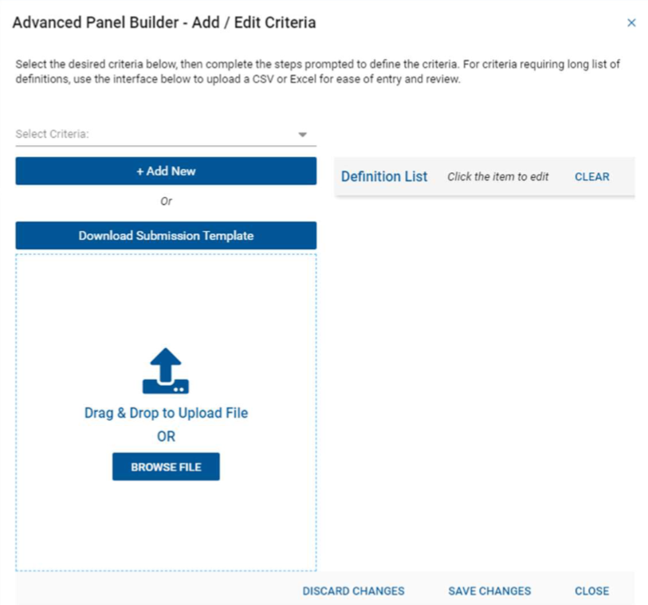
APB Interface – Building Advanced Panels
Click the Criteria button to add filter criteria. This will open a window, shown below on the right, that allows you to select the data element that will define the criteria, as well as the list of values to be considered.
You can manually click on the right-hand side Definition List to add, edit, or remove values, or ‘Clear’ the list by clicking the corresponding button.

Slide 42
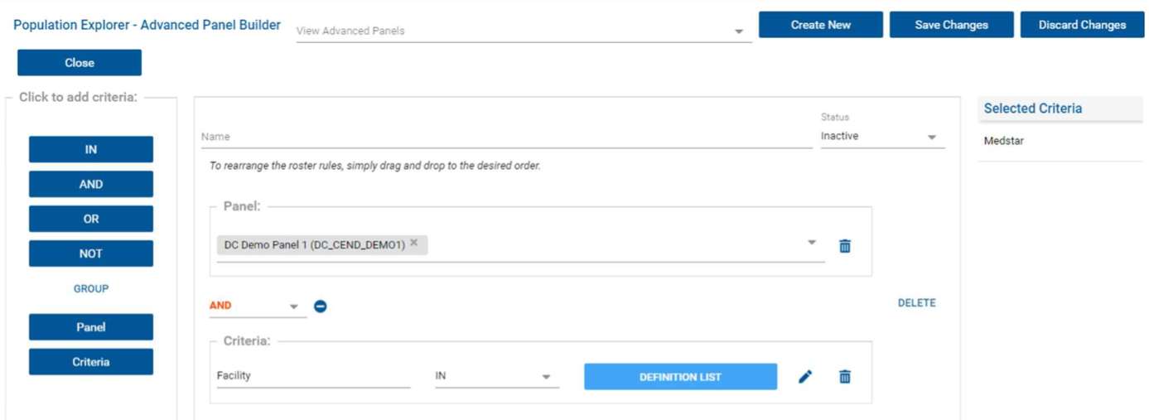
Using APB
If a data element has a defined set of values, these will pre-populate in the right-hand side of the dialogue box; simply click the trash can icon to remove values which are not wanted.

Slide 43
Using APB cont.
You may add as many criteria as needed to define the advanced panel. Use the logical operators above (IN, AND, OR, NOT) between criteria to join them.
If a set of criteria needs to be considered together (for example, “A AND (B OR C)”), use the Group operator to create containing parentheses sets.
Any criteria or operators can be dragged and dropped vertically in the UI to re-order them after they have been placed, and clicking the trash can icon or Delete button on the right-hand side of the screen will remove the selected element.

Slide 44
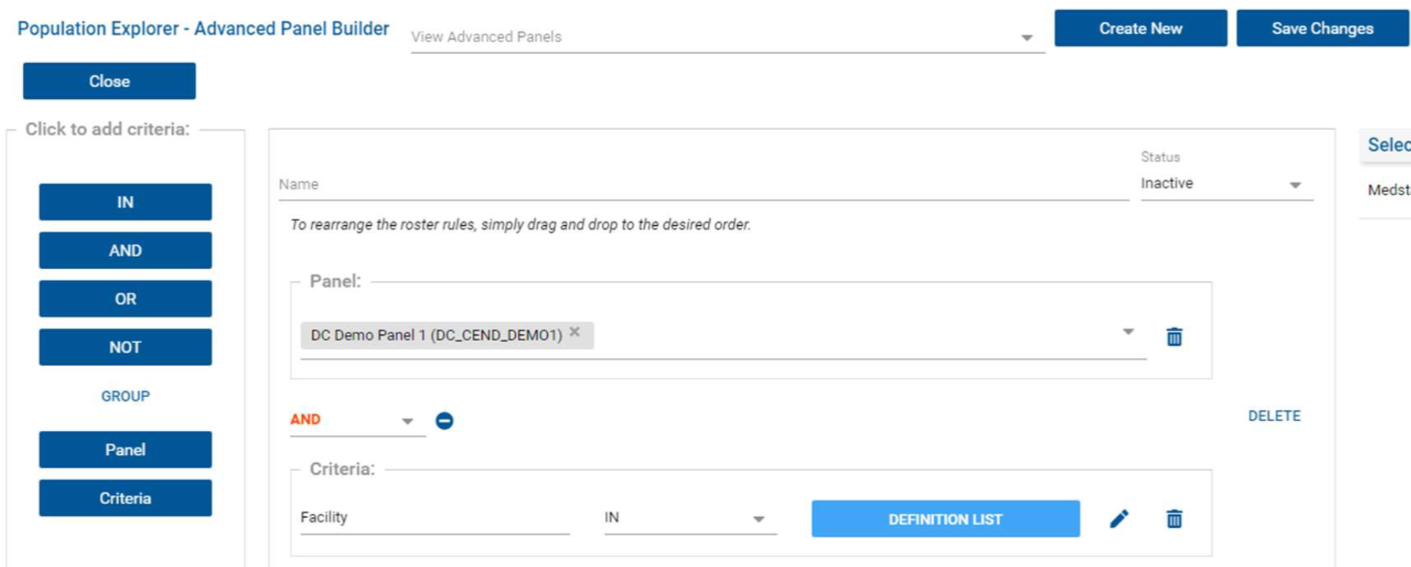
Using APB cont.
A definition list for any criteria can be viewed by simply clicking the ‘Definition List’ button after it has been created, and likewise, existing definition lists can be edited by clicking the pencil icon next to the Definition List button.

Slide 45
Data Exports
The top “Export” button allows users to export all encounters associated with the selected panel. Export is only available to CSV for an entire panel.
The bottom “Export” button allows users to export the selected patient’s encounter. Export is available to PDF &CSV for a single patient.

Slide 46
Consent Tool
The CRISP Consent Tool was designed as a platform for providers and staff to register patient consents to share 42 CFR Part 2-protected data.​
This application has since grown to cover other unique scenarios where patients may need to "opt in" to sharing additional data types via the HIE​
What is my patient consenting to with a 42 CFR Part 2 consent?​
To allow their 42 CFR Part 2-covered provider to share information about their Substance Use Disorder (SUD) treatment via the Health Information Exchange (HIE).​
The HIE will then share it with other members of the patient’s health care team​ who participate with CRISP HIEs​
Including Maryland, DC, West Virginia, Connecticut, Alaska, Virgina, Rhode Island, and any HIE affiliates in the future.

Slide 47
Consent Tool
Registering Consents Already on File
If the consent has been captured outside of the HIE portal, a credentialed staff member may complete the registration in the Consent Tool, based on the patient's designation, before checking the “Attestation for Consent on File” box in the signature section.​
Please keep the signed copy of the consent form on file. It is required by federal law to have a patient signature to share the patient’s SUD information available upon request.
Using the CRISP Consent Tool for In-Person Visits
HIE user searches for their patient in HIE Portal or through SSO in their EHR.​
After launching the tool, provider explains the consent to their patient, educating them on what data they are sharing and with whom.​
Patient designates to share "all SUD data". ​
Patient (or parent/guardian) signs directly in the tool during the in-person visit.​
The provider registers their own legal attestations in the tool and then adds their name before submitting the consent.

Slide 48
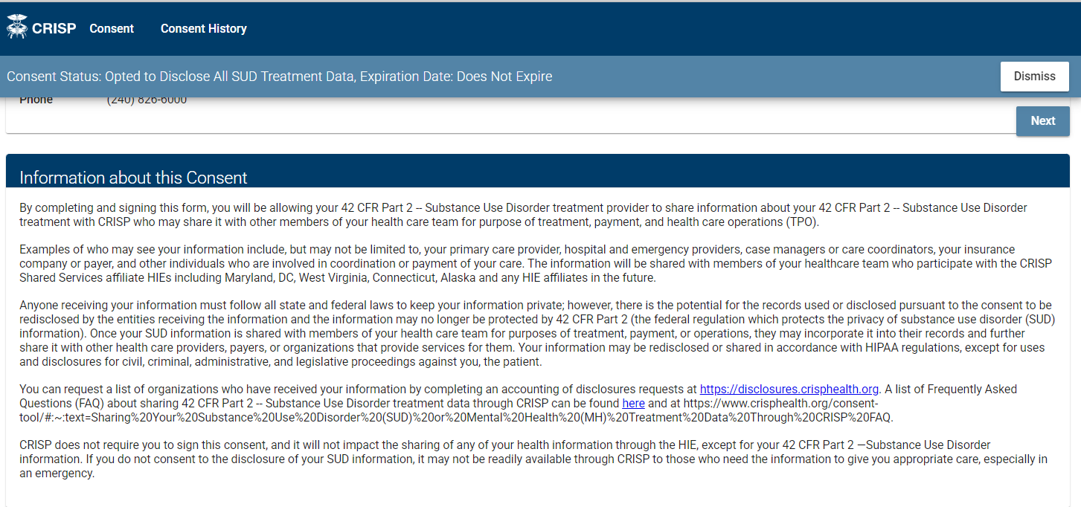
Review the Information Section with patient, using the Accounting of Disclosures and FAQ links as needed
https://www.crisphealth.org/consent-tool/#sharing-data--faq

Slide 49
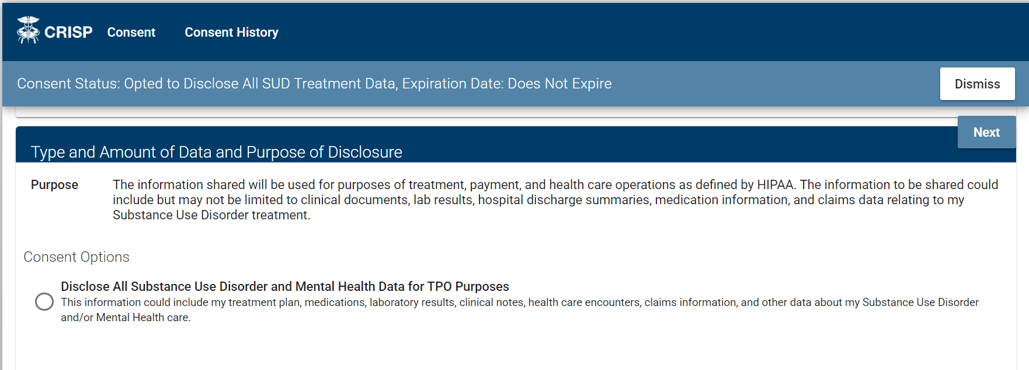
Patient must elect to share ALL SUD information with this form

Slide 50
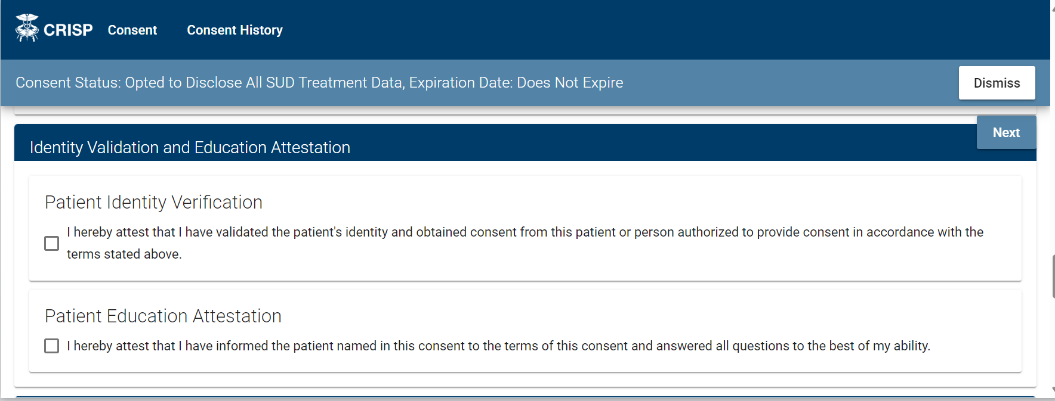
Complete Provider Attestations
Providers/staff obtaining patient consent must attest that they have:
(1) Verified the patient identity and;
(2) Informed the patient of all terms of the consent.

Slide 51
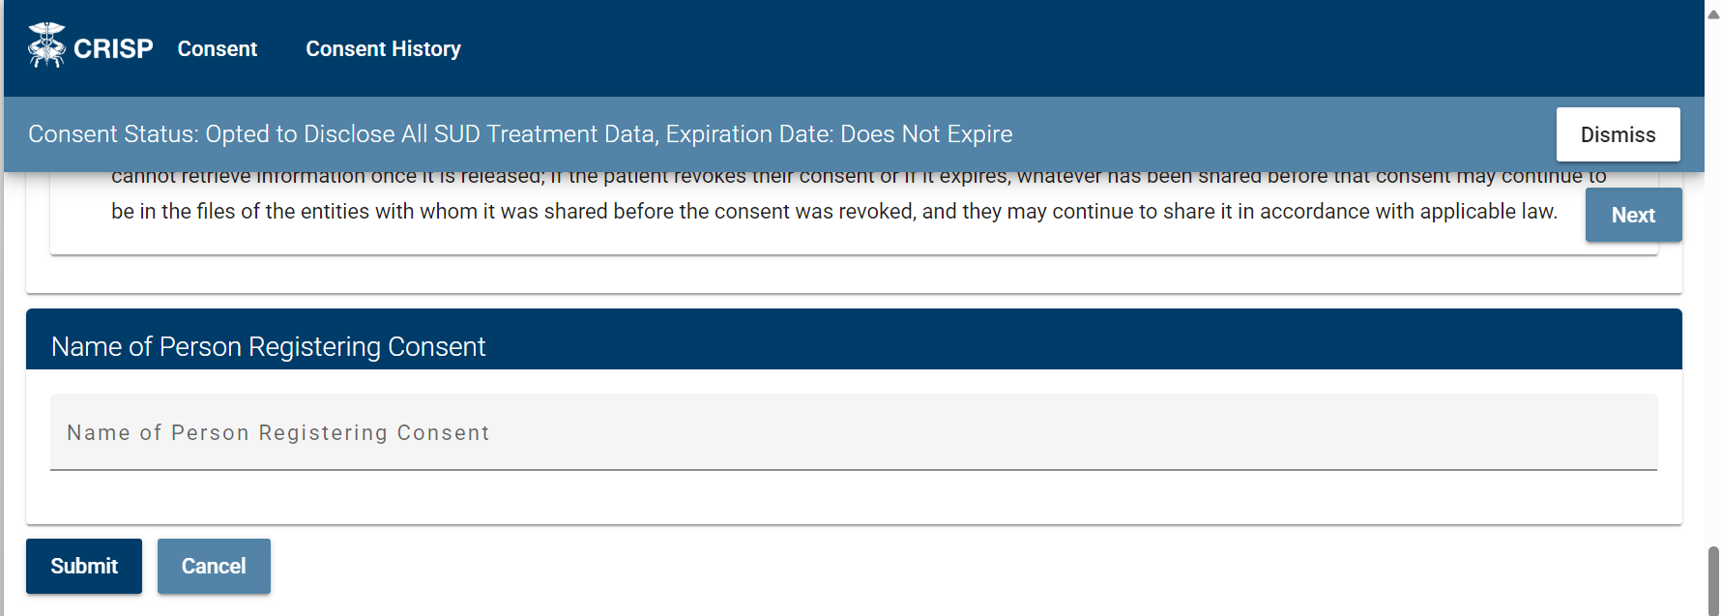
Submit Consent
Enter the name of the person registering this consent.
Click "Submit" once – to avoid duplicate entries.
Click "Print and Exit" or "Exit."

Slide 52
Viewing Consent History
After searching for your patient, click "Consent History."​
Click on a row to open that consent.​
A pop-up window will appear with the consent registration details.​

Slide 53
Printing a Consent Registration
Providers may review, print, or save a registered consent as a file.​
Search for a patient and open a record in their consent history.​
Scroll to the bottom of the window and click "Print."​
A print preview will appear where providers can make selections for how to print the file.​

Slide 54
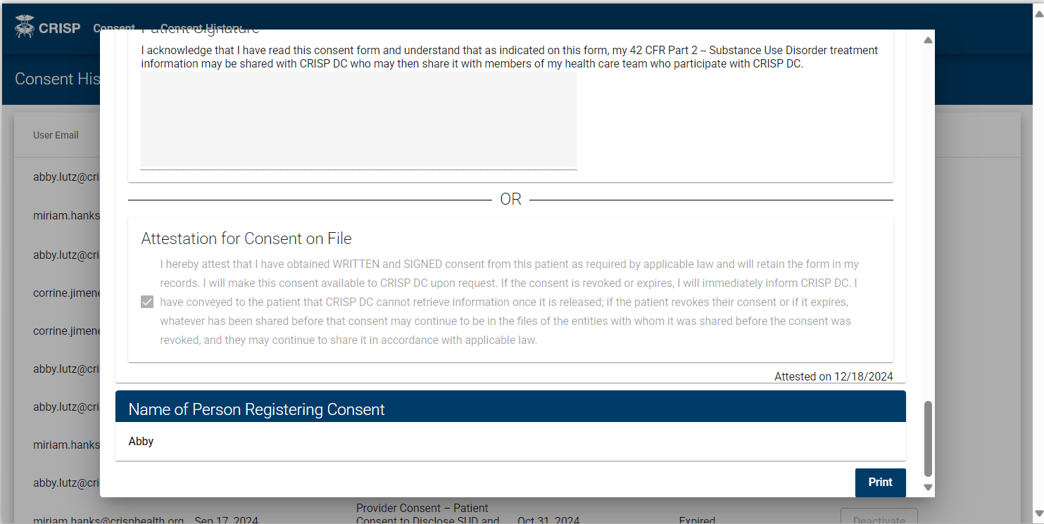
How to print a consent registration
Right Click and Scroll to the bottom of pop-up window

Slide 55
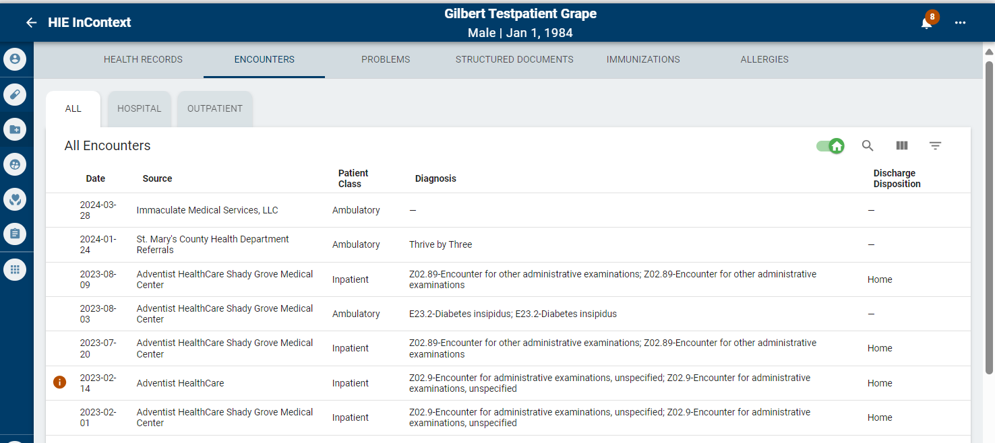
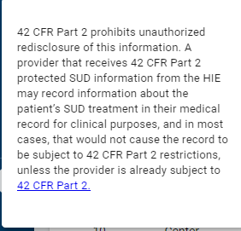
How to view a patient’s SUD Data
Once consent is submitted for a patient their SUD data covered by 42 CFR Part 2 will be identified within the CRISP HIE with an orange ‘i’
This makes the data easily identifiable amongst other clinical data within the HIE.

Slide 56
Referral Tool
CRISP offers a tool allowing providers to view and submit patient referrals directly in their EMR interface.
Referrals can be submitted to any organization in the MD211’s database, containing over 7,000 resources.
The MD211 database is a statewide network powered by the Maryland Information Network (MIN) aiming to connect MD residents to health and human services.
The Referral Tool can be accessed both through the web-based CRISP Portal and through InContext.
To view patient referral history in both the CRISP Portal and InContext, select the Care Coordination tab after searching for the patient.

Slide 57
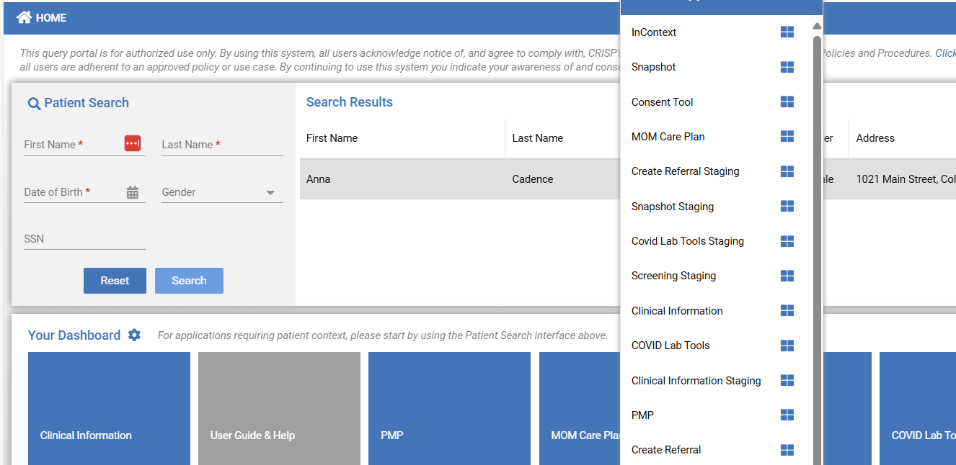
Submitting a Referral
To submit a referral through InContext, launch CRISP through your EMR. Then, select “Create Referral” from the side bar. This will open the referral search in another tab.
To submit a referral through the CRISP Portal, search for the patient and click on their row. From the list of applications that pops up, select “Create Referral.”

Slide 58
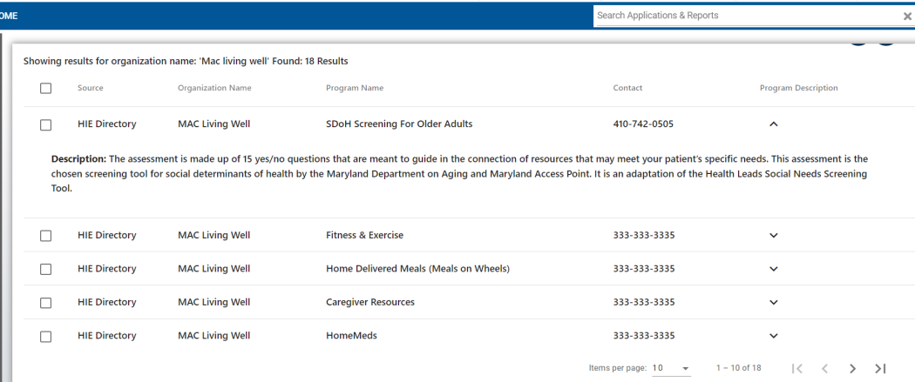
Submitting a Referral cont.
In the form, you can either search for a specific organization, or you can search by resource category within a specific radius.
Select the drop-down arrow to view more information about each program.
Click the checkbox next to the program to which you want to submit the referral and select the “Create Referral for Program” button.

Slide 59
Submitting a Referral cont.
Clicking “Create Referral for Program” will open the Referral Web form. All required fields in the form are marked with an asterisk. At the bottom of the page, users have the option to add relevant files.
The “Referring Provider” section requires information about the user entering the referral in CRISP.
After clicking submit, users will be led to a confirmation page with the option to download.

Slide 60
CRISP Reporting Services (CRS)
CRISP Reporting Services (CRS) built a reporting analytic tool focused on claims data (health care financial transactions for patient visits).
CRS hosts a portal providing users with access to reporting tools to filter and query data from past claims and identify opportunities for improvement.
Using multiple data sources, CRS offers a unique perspective on readmission rates, potentially avoidable utilization, and other critical measures.

Slide 61
Access to CRS: Role Manager
The hMetrix Role Manager handles authorization management for all CRISP Reporting Services data and applications
Access to CRS via the CRISP Portal requires a separate CRS Administrator to provision access through the Role Manager service.
To access the Role Manager, the CRS Administrator must first be provided with the correct account permissions through Salesforce.
The CRS Admin must have an account in the HIE Portal and be granted the asset corresponding to the ‘ReportingRM’ product code. In the Role Manager itself, that user also needs to be granted the appropriate administrative user role.

Slide 62
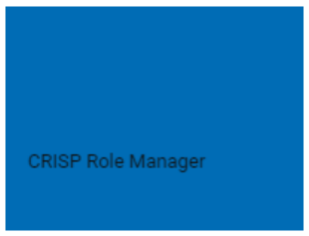
Access to CRS: Role Manager
Once you have the correct permissions, you can access the Role Manager via the HIE Portal in the same fashion as any other integrated service provider, as follows:
Sign into the HIE Portal for the appropriate environment you wish to administer using a modern web browser at https://portal.crisphealth.org.
Click the “CRISP Role Manager” tile (shown at right).
The Role Manager will open in a new tab of the browser

Slide 63
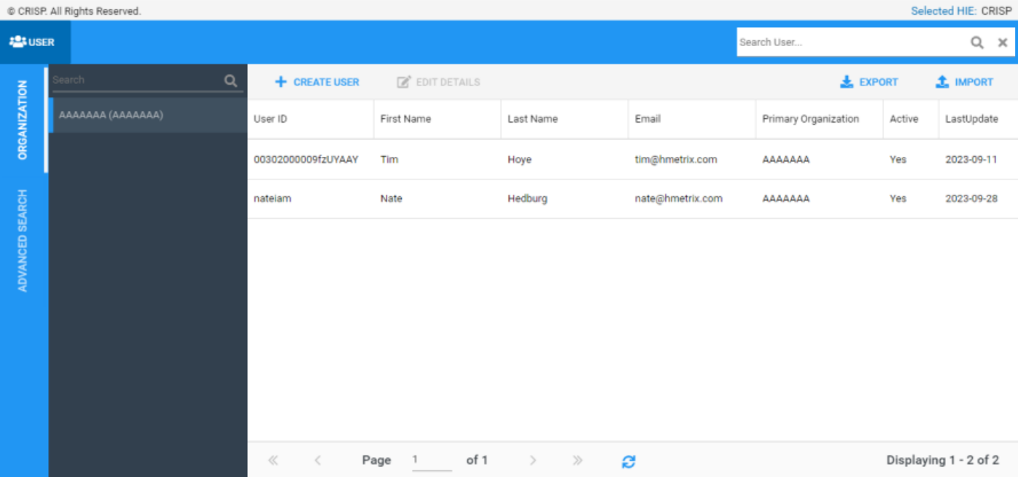
Access to CRS: Role Manager
The user section of the site allows for the assignment of roles, role profiles, and/or organization role profiles to a user or group of users. This is where the bulk of POCs workflows will take place.
Key Features:
Searching for users and organizations
Creating, editing, activating and deactivating users
Exporting and Importing Users
For more in depth information on how to
use the Role Manager, view the user guide here.

Slide 64
Available Reports
All Payer Population Reports
Contain mostly claims data from the Maryland All Payer Case Mix dataset – some reports use datasets from Medicaid and Medicare.
HSCRC Regulatory Reports
Monthly or quarterly regulatory reports produced together with the Maryland Health Services Cost Review Commission (HSCRC).
Reports monitor hospitals based on the HSCRC quality programs.
Medicare Population Reports
Based on the Claim and Claim Line Feed (CCLF) data
Public Health Reports
Reports that support Statewide Public Health Programs, Monitoring, and Research

Slide 65
Contact and Resources
Training materials, recorded webinars, and patient education flyers can be found at: https://crisphealth.org/
CRISP Support
support@crisphealth.org
877-952-7477

Slide 66
Questions?
10480 Little Patuxent Parkway, Suite 800
Columbia, MD 21044
877.952.7477 | info@crisphealth.org
www.crisphealth.org

Slide 67
10480 Little Patuxent Parkway, Suite 800
Columbia, MD 21044
877.952.7477 | info@crisphealth.org
www.crisphealth.org

