Slide 1
HSCRC/CRISP/MEDISOLV
Maryland Hospital Digital Quality Measures Reporting Program
www.medisolv.com

Slide 2
AGENDA
Overview of National Trends in Quality Measurement and Reporting and how it relates to Hospital Quality Reporting in MD
Medisolv Role
CRISP Role
HSCRC Needs/Requirements
Program Achievements
Lessons Learned
Future Directions

Slide 3
National Trends
In Hospital Quality and Safety Reporting

Slide 4
NATIONAL TRENDS
Federal Government is leading the charge across multiple agencies esp. CMS, CDC and AHRQ
CMS is unique as it is both a Payer and a Regulator. It can mandate reporting of quality data and link it to payments or public reporting and often both.
Most of the investments in quality reporting infrastructure on a national scale including new measure development have been made by CMS
Patient Reported Outcomes – Performance Measures (PRO-PM) and weaving Health Equity into quality measures have been emphasized more recently
Reducing provider reporting burden, making measures meaningful especially for patients, and alignment of measures across government programs measures are some of the key goals
Digital Quality Measures are being developed and currently used to replace Claims based and Abstraction Measures

Slide 5
Traditional
eCQMs
dQMs
PAPER TO DIGITAL REPORTING JOURNEY
Paper Quality Measures
Data from claims, manual chart abstractions and patient experience surveys.
Electronic Clinical Quality Measures (eCQMs)
Data primarily from electronic health records (EHRs)
Digital Quality Measures (dQMs)
Data from EHRs, registries, HIEs, claims, patient experience surveys, etc.
No digital standards
Manual Specifications
Custom programming for computations
Quality Data Model (QDM)
HQMF Specifications
Clinical Quality Language
Reports QRDA I and QRDA III
FHIR QiCore/USCDI+QM Models
Clinical Quality Language
Measure Reports

Slide 6
Hospital eCQMs: 2025 IPPS PROPOSED RULE
Description | Short Name | CMS ID | Program | Finalized | Reporting Year | Required
Safe Use of Opioids - Concurrent Prescribing​ | OPI-1 | 506 | IQR | Yes | Required 2024 | Yes
Cesarean Birth​ | PC-02 | 334 | IQR | Yes | Required 2024 | Yes
Severe Obstetric Complications​ | PC-07 | 1028 | IQR | Yes | Required 2024 | Yes
Hospital Harm – Hypoglycemia​* | HH-Hypo | 816 | IQR | No | Voluntary: 2025, Required: 2026 | Yes
Hospital Harm – Hyperglycemia​* | HH-Hyper | 871 | IQR | No | Voluntary: 2025, Required: 2026 | Yes
Hospital Harm - Opioid-Related Adverse Events*​ | HH-ORAE | 819 | IQR | No | Voluntary: 2025, Required: 2026 | Yes
Hospital Harm – Acute Kidney Injury* | HH-AKI | 832 | IQR | No | Voluntary: 2025, Required: 2027 | Yes
Hospital Harm – Pressure Injury* | HH-PI | 826 | IQR | No | Voluntary: 2025, Required: 2027 | Yes
OP - Excessive Radiation Dose | OP-ExRad | 1206 | OQR | Yes | Voluntary: 2025, Required: 2027 | Yes
IP - Excessive Radiation Dose | IP-ExRad | 1074 | IQR | Yes | 2025 | No
Venous Thromboembolism Prophylaxis ​ | VTE-1 | 108 | IQR | Yes | 2024 | No
ICU Venous Thromboembolism Prophylaxis​ | VTE-2 | 190 | IQR | Yes | 2024 | No
Antithrombotic at Discharge​ | STK-2 | 104 | IQR | Yes | 2024 | No
Anticoagulant at Discharge​ | STK-3 | 71 | IQR | Yes | 2024 | No
Antithrombotic by end of day 2​ | STK-5 | 72 | IQR | Yes | 2024 | No
Hospital Harm – Falls with Injury* | HH-Falls | 1017 | IQR | No | 2026 | No
Hospital Harm – Post-operative Respiratory Failure* | HH-PRF | 1218 | IQR | No | 2026 | No
*From the 2025 IPPS Proposed Rule – this has not been finalized

Slide 7
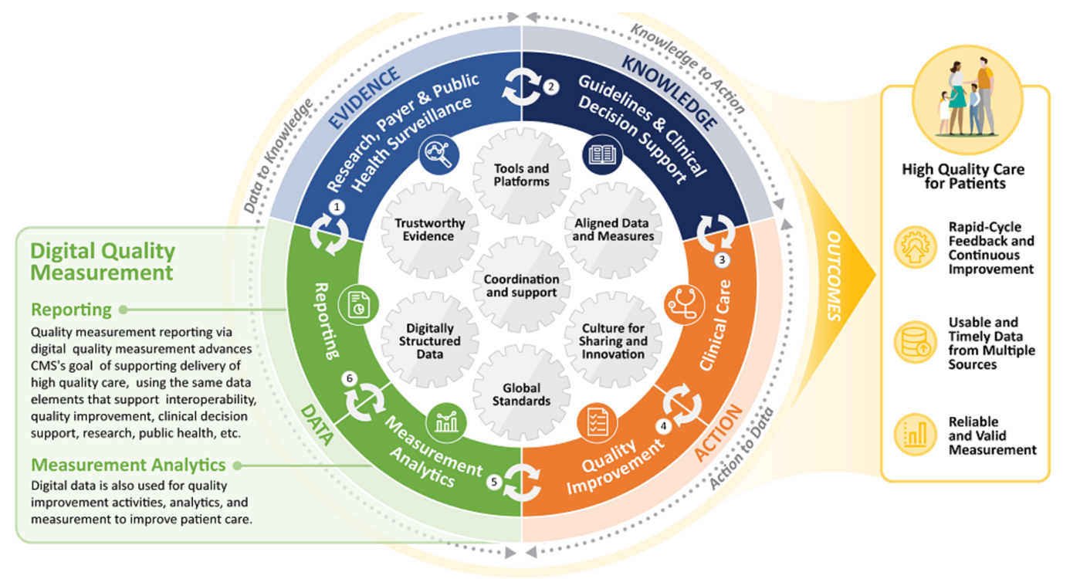
QUALITY MEASUREMENT & THE LEARNING HEALTH SYSTEM

Slide 8
STATEWIDE HOSPITAL eCQM REPORTING IN MD
CRISP
Partnered with the Maryland Health Care Commission (MHCC) to create a state-wide HIE in 2010
CRISP
HSCRC
Only All-Payer hospital rate regulation system in United States
HSCRC
Medisolv
MEDISOLV
Medisolv has 12+ years experience in development and implementation of eCQMs using its Office of National Coordination (ONC) certified software technology for quality reporting by both hospitals and providers

Slide 9
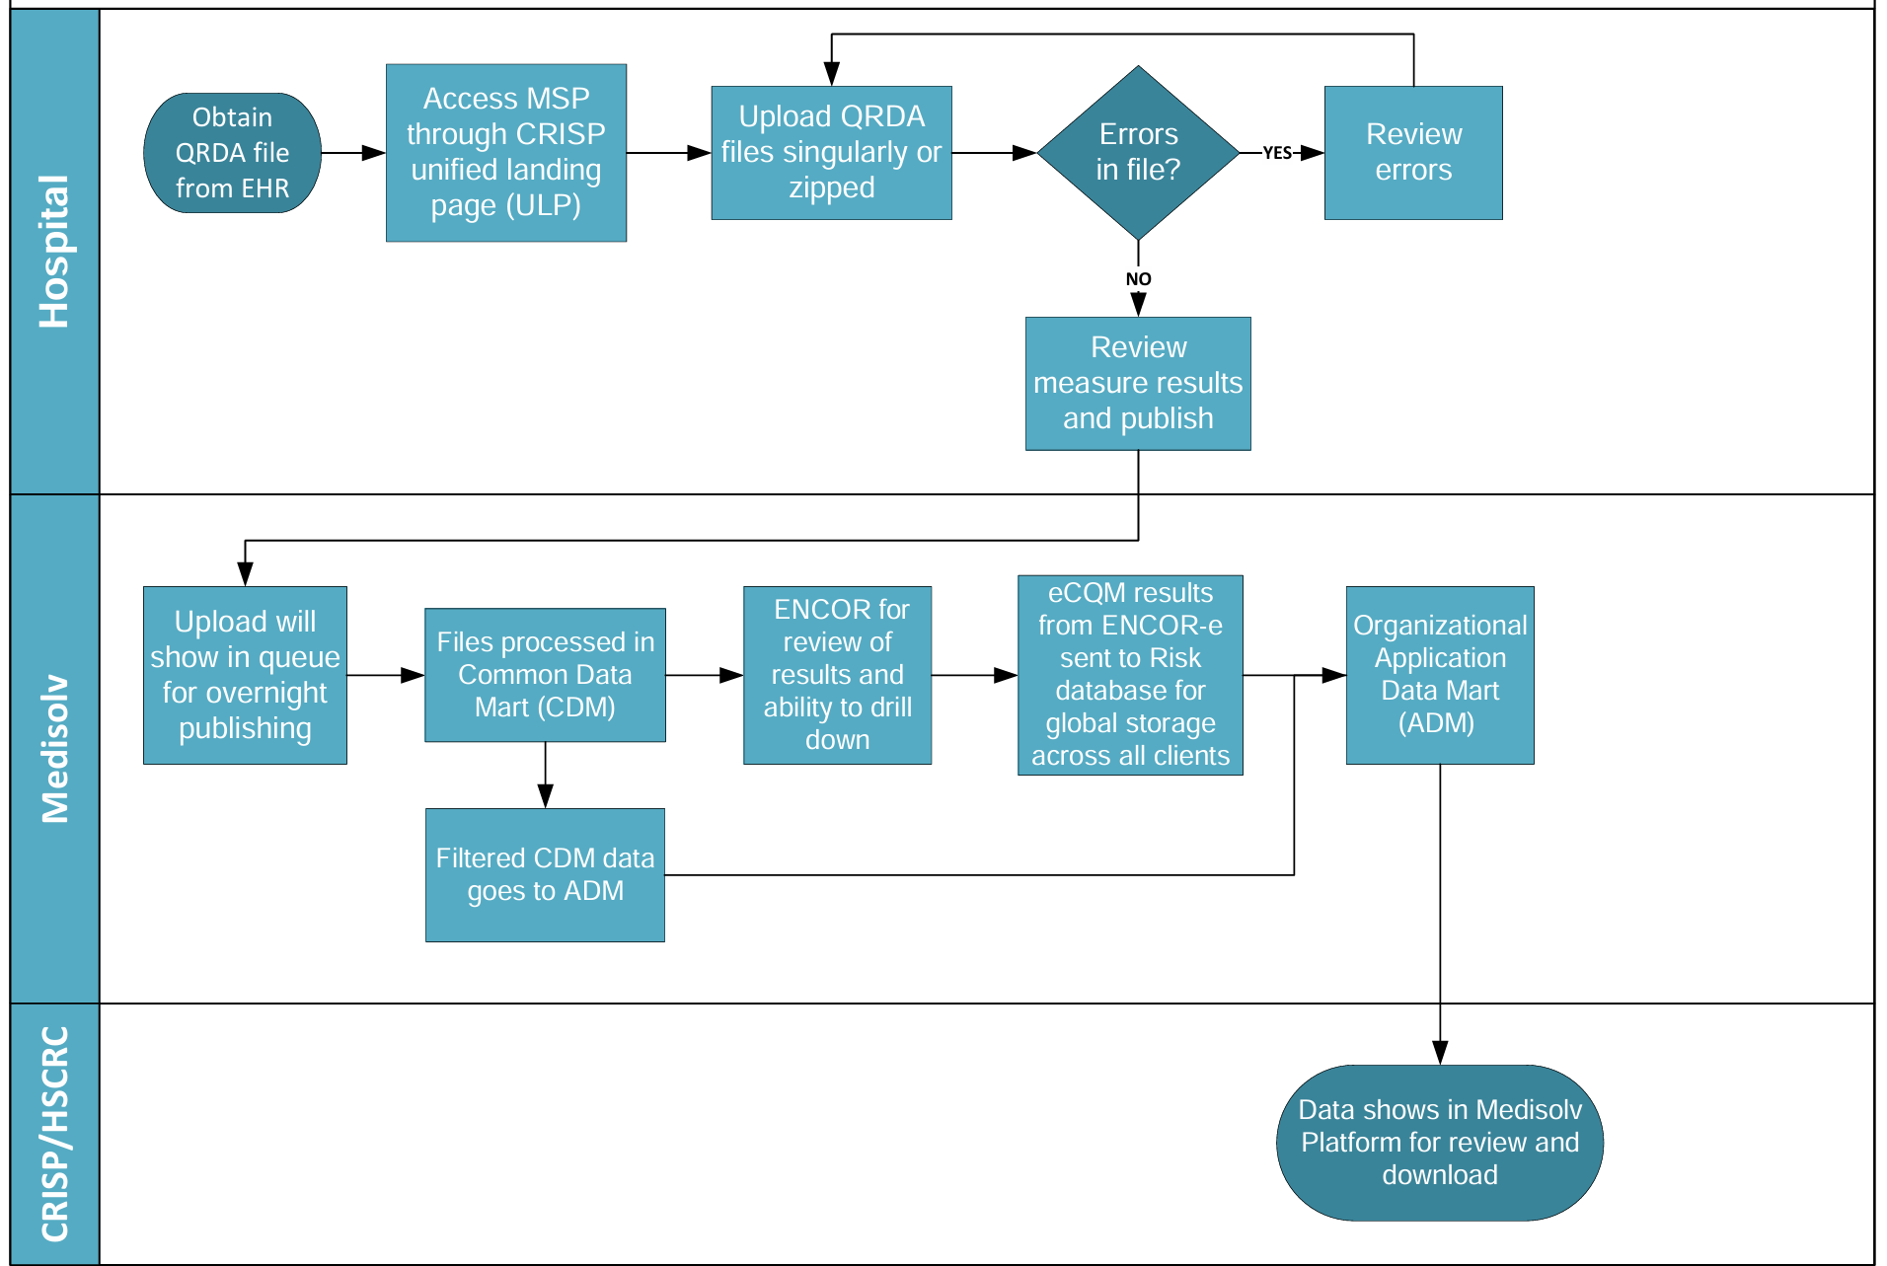
MEDISOLV SUBMISSION PORTAL (MSP)
CRISP Databases

Slide 10
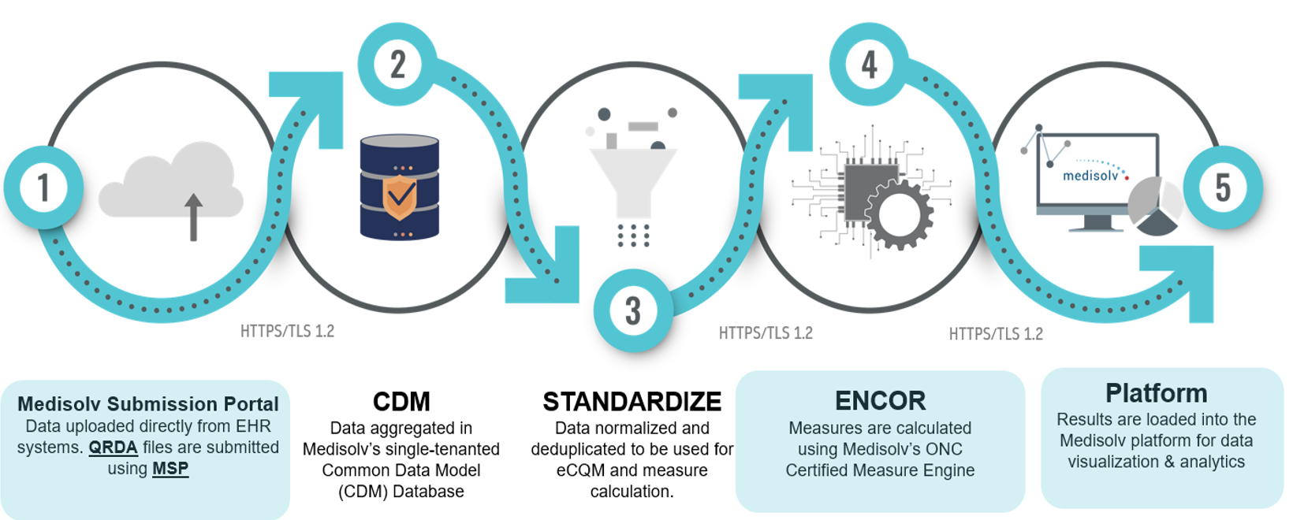
POST SUBMISSION DATA FLOW

Slide 11
DATA SUBMISSION STATUS COMMUNICATION
30 Days Prior to Submission Window Closing
1 Week Before Submission Window Closes
01
02
03
04
05
The Day Submission Window Opens
2 Weeks Before Submission Window Closes
1 Week After Submission Window Closes

Slide 12
About CRISP:
Regional Health Information Exchange (HIE) serving Maryland as the state-designated HIE, and through an affiliation model, sharing technology and support services in with the HIEs in West Virginia, the District of Columbia, Connecticut, Virginia, Alaska, South Carolina, and Rhode Island.
Vision: To advance health and wellness by deploying health information technology solutions adopted through cooperation and collaboration
Mission: We will support the healthcare community of Maryland and our region to appropriately and securely share health information in order to facilitate care, reduce costs, and improve health outcomes.
Guiding Principles
Begin with a manageable scope and remain incremental.
Create opportunities to cooperate even while participating healthcare organizations still compete in other ways.
Affirm that competition and market-mechanisms spur innovation and improvement.
Promote and enable consumers’ control over their own health information.
Use best practices and standards.
Serve our region’s entire healthcare community.

Slide 13
CRISP Support for State Programs in Maryland
Program Administration service line began in 2017 to facilitate Care Redesign Programs
Team has aligned Program Administration to better support CRISP services and participant interventions
Program specific reports
MDPCP Reporting Suite
Multipayer Reporting Suite (new as of December 2023)
Pilots to leverage existing data and services in new ways
Learning System to share best practices

Slide 14
CRISP-MD Quality Programs
In the last four years, CRISP’s Quality Measure Data Collection capacity has expanded significantly:
Work with state and Medisolv to become the first state in the country to accept eCQM data from hospitals
Work with state to accept quality data on behalf of primary care practices for CMS reporting
Partnered with MDPCP on a CDC-funded project to receive eCQMs from primary care practices
Notes:
Peggy

Slide 15
Hospital Reporting of Digital Quality Measures
CRISP and Medisolv are working together to support the HSCRC in collecting hospital-reported digital quality measures.
For more information on the digital quality measures, CRISP maintains the latest timelines, information, and HSCRC updates on the CRISP Learning System website.
Users can access the learning system at crisphealth.org/learning-system/ecqms/

Slide 16
Hospital Reporting of Digital Quality Measures (eCQMs)
Hospitals are required to submit quality performance data on a quarterly basis through the Medisolv Submission Portal (MSP). Hospitals also have access to preliminary submission data through the Encor-E application and finalized submitted data in the Platform application. MSP, Encor-E and Platform can all be accessed through CRISP’s HIE Portal (portal.crisphealth.org) in the 'Medisolv' card.
If you cannot access HIE Portal, please contact support@crisphealth.org

Slide 17
Linking eCQM Data to Case Mix
CRISP receives eCQM data via Medisolv. The eCQM data contains the Facility MRN and hospital. Based on the Facility MRN and hospital, CRISP then uses the CRISP Master Patient Index to add EID (unique identifier). With the EID, HSCRC can link the eCQM data to Case Mix.
Master Patient Index (MPI) = Databases and software used to store patient and link patient information across sources.
EID = Unique identifiers assigned to patients with similar demographic data across different sources.
Medisolv send eCQM data to CRISP
CRISP attaches EID from Master Patient Index and sends data to HSCRC
HSCRC can link eCQM data with Case Mix

Slide 18
Electronic Clinical Quality Measures (eCQM)
Trusted partner for state-based quality initiatives
1st in the nation mandatory quarterly quality reporting for hospitals
Voluntary eCQM data collection and race/ethnicity stratification for ambulatory practices
30
Ambulatory practices submitting eCQM
44
41 hospitals reported all 4 quarters of eCQM data as required by HSCRC
30
MDPCP practices received technical assistance to submit to CMS Quality Payment Program (QPP)

Slide 19
HSCRC: Who We Are
The Maryland Health Services Cost Review Commission (HSCRC) is an independent state agency responsible for regulating the quality and cost of hospital services to ensure all Marylanders have access to high value healthcare.
HSCRC’s vision is to enhance the quality of health care and patient experience, improve population health and health outcomes, and reduce the total cost of care for Marylanders.
The HSCRC establishes rates for all hospital services and helps develop the State’s innovative efforts to transform the delivery system and achieve goals under the Maryland Health Model.

Slide 20
HSCRC Hospital Rate Setting Over Time
Hospital Rate Setting (1970s-2013) Encounter Focus
All-Payer Model (2014-2018): Hospital Focus
Total Cost of Care Model (2019-2028): Health System Focus
Focus on:
Focus on:
Focus on:
Total Cost of Care savings
Hospital charge per case
Hospital savings: Global Budgets
Hospital quality- Expansion
Hospital quality and population health
Hospital charge per visit
Hospital Quality- P4P Introduced
Hospital alignment
System-wide provider alignment, including opportunities for primary care and other non-hospital providers

Slide 21
Hospital Rate Adjustments for Quality
The following are HSCRC’s four main quality-base payment programs
Maryland Hospital Acquired Conditions (MHAC) Program
Encourages hospitals to reduce infections and complications acquired during a hospital stay
Quality Reimbursement Program (QBR)
Focuses on patient experience, patient safety, and clinical quality outcomes
Readmissions Reduction Incentive Program (RRIP)
Encourages hospitals to reduce readmissions within 30 days of discharge
Potentially Avoidable Utilization (PAU)
Focuses on improving patient care and health through reducing potentially avoidable utilization
HSCRC’s quality programs are similar to federal Medicare pay-for-performance programs, but are, wherever possible, All-Payer (instead of Medicare-only). Although not under IPPS, Maryland hospitals must comply with all CMS Inpatient Quality Reporting requirements.

Slide 22
Under the TCOC Model, Maryland has established the Statewide Integrated Healthcare Improvement Strategy
SIHIS is designed to engage State agencies and private-sector partners to collaborate and invest in improving health, address disparities, and reduce costs for Marylanders.
CMMI approved the SIHIS goals in March 2021.
More information on SIHIS can be found on the HSCRC website. https://hscrc.maryland.gov/Pages/Statewide-Integrated-Health-Improvement-Strategy-.aspx
1. Hospital Quality
Shared Goals & Outcomes
3. Total Population Health
2. Care Transformation Across the System

Slide 23
Maryland Statewide Digital Measure Reporting Infrastructure: Important to Achieving Maryland’s Quality Goals
The CMS Digital Quality Measurement Strategic Roadmap issued in March 2022 put forth a timeline of seven years to achieving a fully digital quality measurement enterprise
In July of 2022, HSCRC required Maryland hospitals to submission of Electronic Clinical Quality Measures (eCQM)
Maryland targeted quality improvement using digital measures:
Maryland’s programs are all-payer
ED wait times have been above the Nation for many years
Infrastructure may allow future digital reporting of ED wait times
Hyper- and Hypo-glycemia eCQMs for monitoring, potential public reporting by MHCC:
Safety events are priority for CMS; could be considered in the future for MHAC or QBR
These events “are associated with a range of harms, including increased in-hospital mortality, infection rates, and hospital length of stay” (NQF documentation of developer rationale)
Impact all hospitals
Obstetric morbidity and c-section rates eCQMs (implemented by HSCRC in CY 2023) for monitoring, potential for public reporting by MHCC:
CMS focus (required starting in CY 2024) and related SIHIS priority
Currently tracking statewide, unadjusted rate; SMM is a risk-adjusted measure
Hospitals not eligible for the PC measures must choose other optional measures
Maryland uses all-payer readmission and mortality measures; Hospital Wide Readmission (HWR) and Hospital Wide Mortality (HWM) Hybrid measures, currently Medicare only, will be expanded to all payers.

Slide 24
eCQMs Required by HSCRC for CY 2024
Title | Short Name | CMS eCQM ID | NQF Number | Specifications
Anticoagulation Therapy for Atrial Fibrillation/Flutter | STK-3 | CMS71v13 | Not Applicable | CMS71v13.zip
Antithrombotic Therapy By End of Hospital Day 2 | STK-5 | CMS72v12 | Not Applicable | CMS72v12.zip
Cesarean Birth | PC-02 | CMS334v5 | 0471e | CMS334v5.zip
Discharged on Antithrombotic Therapy | STK-2 | CMS104v12 | Not Applicable | CMS104v12.zip
Global Malnutrition Composite Score | GMCS | CMS986v2 | 3592e | CMS986v2.zip
Hospital Harm - Opioid-Related Adverse Events | HH-ORAE | CMS819v2 | 3501e | CMS819v2.zip
Hospital Harm - Severe Hyperglycemia | HH-Hyper | CMS871v3 | 3533e | CMS871v3.zip
Hospital Harm - Severe Hypoglycemia | HH-Hypo | CMS816v3 | 3503e | CMS816v3.zip
Intensive Care Unit Venous Thromboembolism Prophylaxis | VTE-2 | CMS190v12 | Not Applicable | CMS190v12.zip
Safe Use of Opioids - Concurrent Prescribing | N/A | CMS506v6 | 3316e | CMS506v6.zip
Severe Obstetric Complications* | PC-07 | CMS1028v2 | Not Applicable | CMS1028v2.zip
Venous Thromboembolism Prophylaxis | VTE-1 | CMS108v12 | Not Applicable | CMS108v12.zip
Hospitals must submit total of 7 eCQMs. --Measures in green are required. --Hospitals must select 2 additional measures. *This is a risk adjusted measure. Risk Adjustment Methodology Report: Severe Obstetric Complications Methodology Report Source: https://ecqi.healthit.gov/eh-cah?qt-tabs_eh=1&globalyearfilter=2024&global_measure_group=3716

Slide 25
Hybrid Measures Reporting Required by HSCRC CY 2024
Hospitals are required to submit the Core Clinical Data Elements (CCDE) for the HWR and HWM Hybrid measures covering the performance period July 1, 2023 – June 30, 2024
Required reporting initially on Medicare only patients using the CMS HWR and HWM specifications
Prefer hospitals begin reporting in Q 1 2024 (January), but hospitals with technical issues may report for the year of data beginning July 24
Optionally, hospitals may voluntarily report CCDE Data on Patient >age 17 from All Payers using the HSCRC HWR and HWM specification; two hospitals have submitted.
HSCRC will require hospitals to submit CCDE for the HWR and HWM hybrid measures on patients from all payers >17 yrs. of age using HSCRC specifications with performance beginning in July 1 2024

Slide 26
Digital Measures Project Achievements to Date
Maryland has implemented the first statewide initiative for hospital digital quality measures reporting
Maryland has required all hospitals to submit data on the same group of measures, with additional optional measures selected by the hospital
Maryland has also required more timely submission of data than CMS for near “real time” performance measurement, with most hospitals submitting most measures
Maryland has convened a Digital Measures Work Group comprising hospitals and EHR vendors, Medisolv and CRISP
The Maryland Health Care Commission (MHCC) will begin public reporting eCQM data in July 2024 (safe opioid prescribing measure)

Slide 27
Digital Measures Project Lessons Learned, Next Steps
Lessons:
Some hospitals have struggled to report some eCQM measures, e.g., Perinatal Care Cesarean, Severe Maternal Morbidity, Hospital Harm Hyper- and Hypo-glycemia
Some hospitals’ EHR vendor timelines for measure updates have varied and are not synced with HSCRC timeline
The earlier submission timeline for the Hybrid Measures has also posed a challenge for some hospitals primarily due to EHR readiness
Next Steps:
Continue to move forward with expansion to all payers for HWR and HWM Hybrid measures
Consider ongoing hospital input and feedback on reporting requirements
Continue to develop analytic methodologies for the measures
Over the next one to two years, a subset of digital measures will be vetted for public reporting and/or pay for performance

