Slide 1
Maryland Model Analytics
Evaluation of the Care Transformation Initiatives Program: Year 1 Review
Presented by: Max Sgro, MPP, Project Lead

Slide 2
Contents
Background
Overview of the evaluation
Data Sources and Methods
Key Findings
Conclusions
Q&A

Slide 3
Background
HSCRC established the CTI program to meet requirements of its Total Cost of Care model while allowing hospitals the flexibility to define their own episodes of care and test interventions to determine whether they reduce costs.
Hospitals that conduct CTIs can earn additional payments by achieving savings for their defined episodes during a performance year.
To fund these additional payments in a cost-neutral way, the state will reduce payments to all hospitals, including those that choose not to participate in the CTI program.

Slide 4
Background
CTIs are grouped into thematic areas based on similarities between the clinical interventions used, the settings where the triggering event occurs (such as a hospital or a primary care practice), and how the patient populations are defined.
Care Transitions, which focus on transitional care management such as discharge coordination, home assessments, and telehealth transition services.
Community-Based Care, which target the broader community, including community health workers, providers assigned to senior living buildings, or care coordination for patients transitioning to or from skilled nursing facilities (SNFs).
Emergency Care, which focus on reducing ED visits for patients who are at high risk for ED use (such as high utilizers and individuals who have unmet social needs).
Palliative Care, which focus on managing direct care of chronic pain patients, improving advanced care planning, and coordination with home health, hospice, and SNF.
Primary Care, which is for hospitals that have programs to improve their primary care services, such as wrap-around services or completion of social, behavioral, and home safety assessments, or referrals to community resources.

Slide 5
Overview of the evaluation
AIR evaluated the CTI program in two parts:
Part 1 of the evaluation reviewed CTIs during the pre-implementation period. This evaluation described how hospitals designed their CTIs, identifies areas of spending that are (or are not) addressed by CTIs, assesses how CTIs align with published research on care transformation, and describes the extent to which CTIs address socioeconomic status and race and ethnicity.
Part 2 is a follow-up from the first year of the CTI program, which ended in June 2022. This evaluation looks at which CTIs achieved savings, includes feedback from participants, and offers recommendations on how the CTI program could be improved or expanded.

Slide 6
Data Sources and Methods
AIR used a mixed-methods approach to evaluate the CTI program for the Year 1 review.
Data Analysis. We analyzed descriptive and cost data on CTIs that were active during the first performance year of the program (2021-2022)
AIR conducted an independent quantitative analysis of the CTI data in February 2023 using data provided by CRISP. Because Year 1 performance data were not finalized at the time of this evaluation, the results presented should be considered preliminary and may not be equivalent to cost calculations conducted by HSCRC.

Slide 7
Data Sources and Methods (cont.)
CTI Data. CTI data was summarized to describe the following:
Total cost of each CTI compared with the total target cost
Total per-episode cost of each CTI compared with the target per-episode cost
Comparison of the number of episodes for each CTI during the performance year and at baseline
Average CTI total cost compared with target cost for CTIs that identify as having an SDOH focus
Average total cost compared with target total cost, by thematic area

Slide 8
Data Sources and Methods
Survey. We conducted an online survey (12 questions) of CTI participants to capture their perspectives during the pre-implementation phase. We fielded the survey to 92 contacts and received 21 responses.
Key Informant Interviews. 45-minute interviews with representatives from seven hospitals to gather information on the details of each hospital’s CTI, the implementation process, any successes and challenges from the first year of the program, CTIs (if any) that were found to be reducing costs, and feedback for CRISP and HSCRC staff.

Slide 9
Key Findings
CTIs covered 243,081 Medicare fee-for-service beneficiaries in Maryland, nearly a quarter of the 1 million beneficiaries who have Medicare Parts A and B coverage in any given month.
Nearly 75 percent of first-year CTIs are in Care Transitions or Primary Care
Thematic Area | Number of CTIs | Total Number of Patients at Baseline | Total number of Patients at Year 1
Care Transitions | 55 | 35,612 | 22,148
Community-Based Care | 10 | 29,985 | 29,731
Emergency Care | 13 | 17,314 | 13,411
Palliative Care | 4 | 986 | 494
Primary Care | 22 | 149,331 | 177,297
Total | 104 | 233,228 | 243,081

Slide 10
Key Findings
CTIs vary widely in the number of episodes available in baseline data and number of episodes completed during the performance year. This variation reflects differences in patient populations and the length of episodes.
Note. *Episode counts are masked when there are fewer than 12 episodes, as CTIs with fewer than 12 episodes are disqualified from final cost calculations.
Thematic area | Mean |  | Minimum |  | Maximum
 | Baseline | Performance | Baseline | Performance | Baseline | Performance
Care Transitions | 713 | 432 | 15 | 1* | 2,907 | 2,321
Community-Based Care | 3,050 | 2,989 | 29 | 26 | 22,556 | 24,970
Emergency Care | 1,624 | 1,207 | 13 | 1* | 5,531 | 3,393
Palliative Care | 168 | 124 | 1* | 24 | 342 | 223
Primary Care | 7,262 | 8,087 | 82 | 76 | 32,525 | 35,642

Slide 11
Key Findings
The target price per episode depends on the number of available baseline episodes, the variation in costs for those episodes, patient complexity and care needs, and the types of costs that hospitals chose to include in the episode.
The final target price of each CTI are updated from the baseline period to account for risk adjustment and inflation. We see that there are small differences in target price between the preliminary and final calculations
Thematic area | Minimum |  | Mean |  | Median |  | Maximum
 | Preliminary | Final | Preliminary | Final | Preliminary | Final | Preliminary | Final
Care Transitions | $9,048 | $9,243 | $34,438 | $36,027 | $34,805 | $35,976 | $87,369 | $101,008
Community-Based Care | $12,027 | $11,161 | $27,378 | $28,648 | $29,092 | $30,027 | $43,831 | $43,798
Emergency Care | $8,203 | $7,763 | $14,552 | $14,781 | $11,165 | $12,282 | $29,871 | $28,953
Palliative Care | $34,417 | $34,774 | $48,808 | $42,040 | $42,287 | $42,784 | $88,197 | $49,572
Primary Care | $3,952 | $3,791 | $14,562 | $13,046 | $13,502 | $12,662 | $35,182 | $36,271
Note. Estimated Final Target Prices reflect data available as of February 2023 and should not considered final.

Slide 12
Key Findings
Nearly all Maryland hospitals (90 percent) are participating in the CTI program, and most are motivated by the potential to earn savings.
Hospitals are participating in CTIs to earn potential savings; to continue work they were already engaged in and be formally evaluated; to avoid financial penalties.
About half of respondents said that their CTI was intended to address an area of high spending, while the other half said this was not the purpose of their CTI.

Slide 13
Key Findings
On average, across all CTIs, mean total costs in excess of target total costs were $1,053,974.
CTIs related to Primary Care were shown to perform closer to target costs, on average, than did other thematic areas.
Thematic area | Minimum | 25th percentile | Median | Mean | 75th percentile | Maximum
Care Transitions | ($17,072,966) | ($1,418,973) | ($414,767) | ($1,282,761) | $48,498 | $1,267,724
Community-Based Care | ($6,283,791) | ($1,280,090) | ($741,653) | ($654,570) | $153,237 | $4,939,703
Emergency Care | ($13,556,289) | ($2,156,208) | ($579,958) | ($2,353,462) | ($46,807) | $247,297
Palliative Care | ($3,274,915) | ($1,069,994) | ($75,674) | ($463,637) | $530,683 | $1,571,716
Primary Care | ($8,444,878) | ($4,453,864) | ($702,290) | ($36,631) | $1,523,734 | $16,228,537

Slide 14
Key Findings
Overall, 33 of the 104 CTIs had lower costs than the performance target and generated savings.
CTIs that achieved savings represented nearly one third of implemented CTIs and included all thematic areas.
Thematic area | Number of CTIs | Number of CTIs with cost savings | Percent of CTIs with cost savings
Care Transitions | 55 | 17 | 31%
Community-Based Care | 10 | 4 | 40%
Emergency Care | 13 | 2 | 15%
Palliative Care | 4 | 2 | 50%
Primary Care | 22 | 8 | 36%

Slide 15
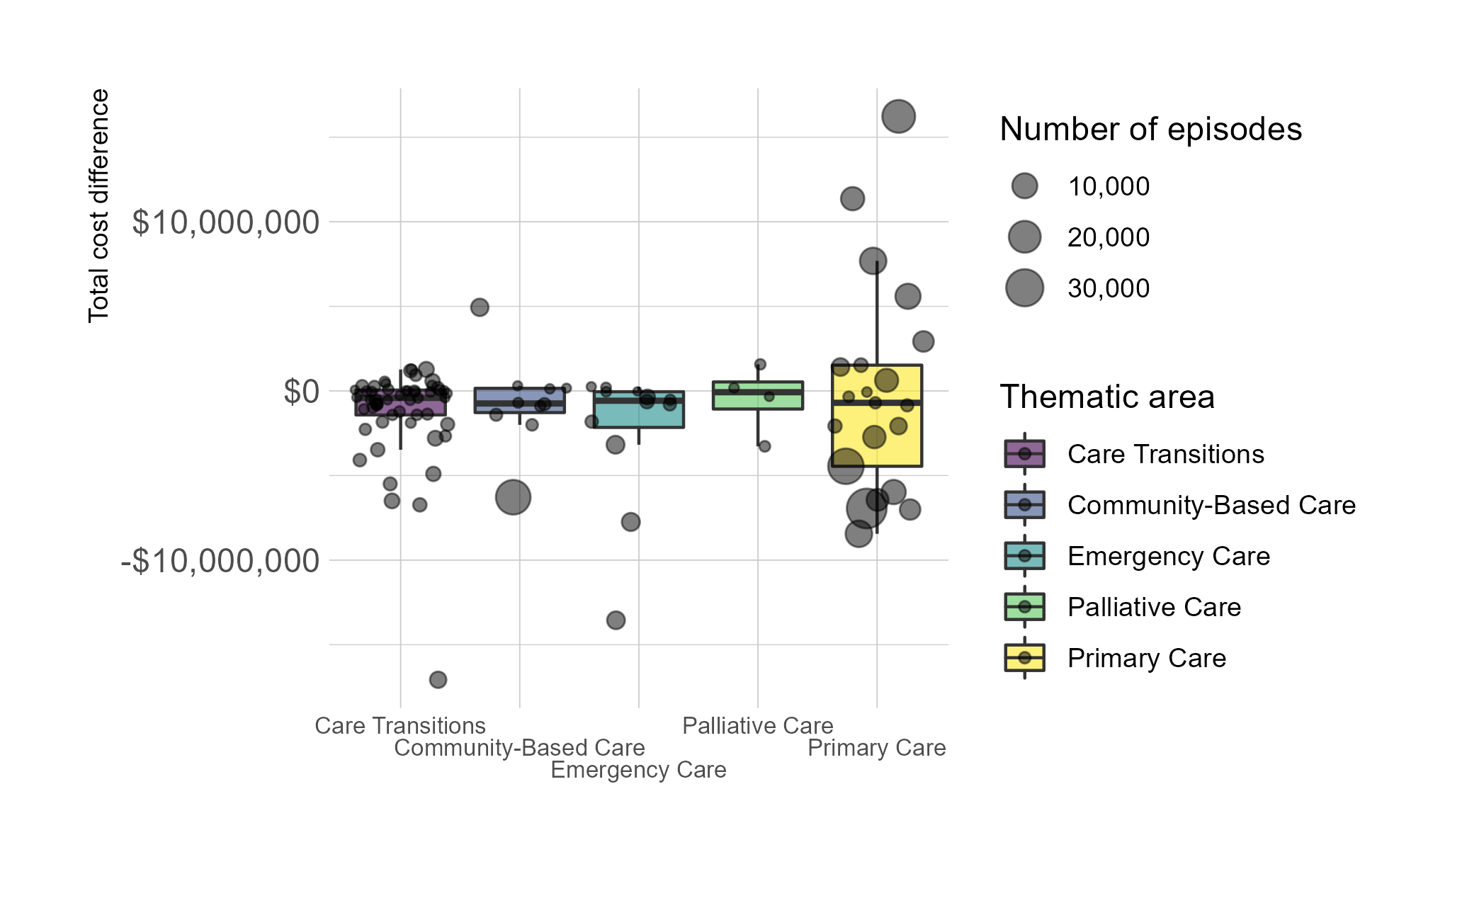
Key Findings
Boxplot of Total Target Costs Minus Total Performance Costs, by Number of Episodes

Slide 16
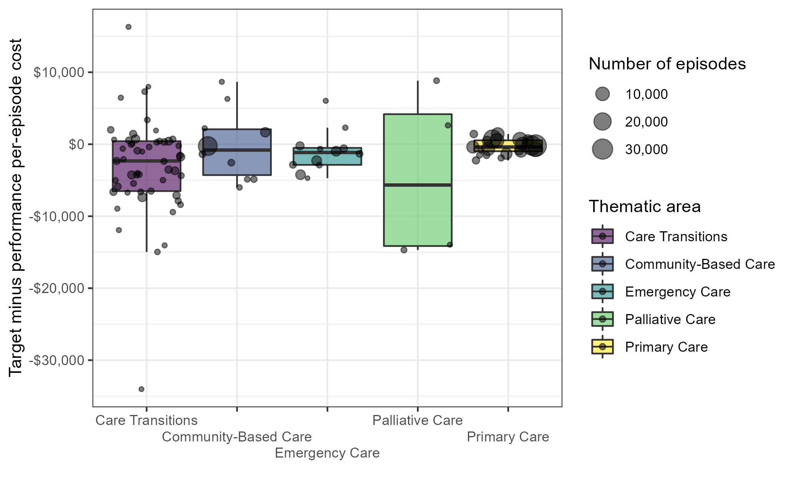
Key Findings
Boxplot of Difference Between Target Per-Episode Cost and Performance Per-Episode Cost, by Number of Episodes

Slide 17
Key Findings
Many CTIs had a low number of total episodes, and the majority of CTIs had fewer episodes during the performance year than in the baseline period.
The only thematic area that had more episodes, on average, in the performance year than the baseline period was Primary Care
Thematic area | Number of CTIs | Median* | Mean
Care Transitions | 55 | -162.0 | -288.8
Community-Based Care | 10 | -163.5 | -171.7
Emergency Care | 13 | -211.0 | -612.6
Palliative Care | 4 | -161.5 | -115.3
Primary Care | 22 | 215.0 | 482.5
*Performance number of episodes minus target number of episodes. Negative values indicate fewer episodes than baseline period.

Slide 18
Key Findings
CTIs with an SDOH focus averaged better performance than CTIs that did not address SDOH.
Four of the five thematic areas CTIs that were described as having an SDOH focus had, on average, lower total costs and lower negative savings (losses) than did CTIs without this focus
Thematic area | SDOH focus | Number of CTIs | Average savings in total costs
Care Transitions | Yes | 22 | -$559,227
Care Transitions | No | 33 | -$1,796,236
Community-Based Care | Yes | 1 | -$781,481
Community-Based Care | No | 9 | -$640,469
Emergency Care | Yes | 7 | -$1,814,524
Emergency Care | No | 6 | -$3,107,976
Palliative Care | Yes | 1 | $183,672
Palliative Care | No | 3 | -$679,406
Primary Care | Yes | 9 | $514,014
Primary Care | No | 13 | -$449,615
Note. Savings represent the target total costs minus the performance total costs. Positive values indicate that the CTI had overall savings.

Slide 19
Key Findings
CTI design and implementation were driven by participating hospitals' strengths.
The majority (18, 86%) felt that the implementation was positive or somewhat positive.
Survey and interview responses indicated that successful CTIs were developed by hospitals with existing programs that could be implemented as part of the CTI program

Slide 20
Key Findings
Hospitals identified challenges with implementation.
Small number of episodes: A majority of survey respondents (14, 67%) mentioned challenges in identifying and capturing the intended patient population using data.
COVID-19: A majority of survey respondents (13, 62%) mentioned ongoing challenges related to COVID-19, mostly related to labor and workforce shortages.
Data lag: Many interviewees mentioned that the inherent data lag with claims made it difficult to quickly modify underperforming CTIs. Some CTI participants developed their own metrics.
CRISP data clarity and filtering options: Feedback from CTI participants indicated that they found the CRISP portal to be helpful, but they had limited knowledge on the ability to drill down into patient-level data and identify true triggering episodes.

Slide 21
Key Findings
Hospitals identified future changes they would like to see.
Support from the State of Maryland: Interviewees praised CRISP for its responsiveness to questions and suggestions, saying that they felt heard and that complaints/suggestions were taken seriously. However, some interviewees felt that HSCRC could improve responsiveness and found the frequent program changes difficult to track.
Cost methodology: In both surveys and interviews, CTI participants mentioned the cost methodology's complexity and a desire to more clearly see the calculations of each CTI target price and total savings.
Sharing best practices: Interviewees unanimously agreed that it would be helpful to connect with other CTI participants on CTI-related topics, with an emphasis on hearing from "success stories" in an online forum.

Slide 22
Conclusions
Hospitals are committed to quality improvement and motivated by the CTI financial incentives but require ongoing technical assistance with designing episodes and understanding the methodology
CTIs with a large number of episodes and performance costs below target are necessary for generating significant savings.
Hospitals are seeking up-to-date, detailed data to analyze program effectiveness
CTI participants would like CRISP to facilitate more hospital collaboration to share best practices

Slide 23
THANK YOU!
Questions?

