Slide 1
Healthcare Provider Directory
High-Level Overview
January 4, 2017
Seth.Sacher@crisphealth.org

Slide 2
Agenda
CRISP Website – RFP Information
Overview of CRISP
CRISP Architecture
What is a Healthcare Provider Directory?
RFP Expectations
Healthcare Provider Directory Architectural Landscape
Review Supporting Material
Q&A

Slide 3
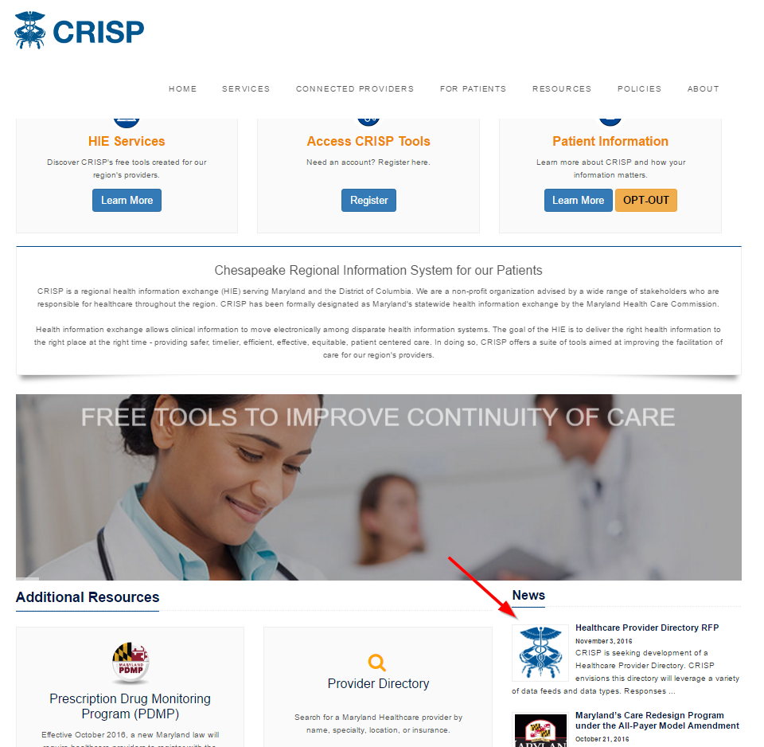
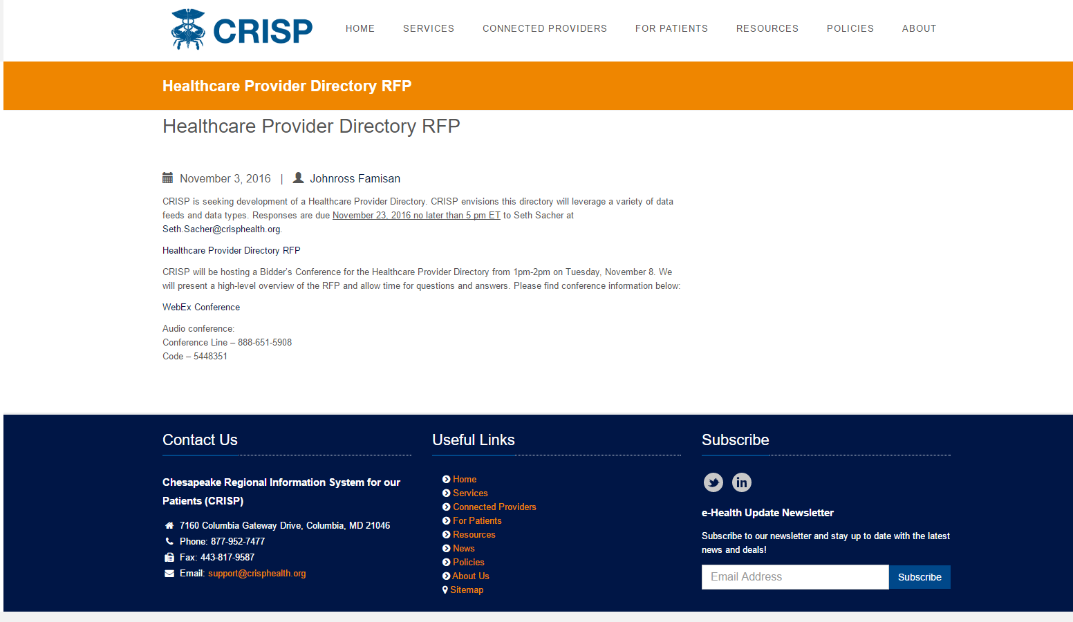
CRISP Website
https://crisphealth.org/
https://crisphealth.org/healthcare-provider-directory-rfp/

Slide 4

Who We Are
CRISP is a regional health information exchange (HIE) serving Maryland and the District of Columbia. We are independent not-for-profit membership corporation advised by a wide range of stakeholders who are responsible for healthcare throughout the region. CRISP has been formally designated as Maryland's statewide health information exchange by the Maryland Health Care Commission.
Notes:
Source: https://crisphealth.org/about/

Slide 5
Our Mission
We will enable and support the healthcare community of Maryland and our region to appropriately and securely share data in order to facilitate care, reduce costs, and improve health outcomes.
Notes:
Source: https://crisphealth.org/about/

Slide 6
Our Vision
To advance health and wellness by deploying health information technology solutions adopted through cooperation and collaboration.
Notes:
Source: https://crisphealth.org/about/

Slide 7
Our Guiding Principles
Begin with a manageable scope and remain incremental.
Create opportunities to cooperate even while participating healthcare organizations still compete in other ways.
Affirm that competition and market-mechanisms spur innovation and improvement.
Promote and enable consumers’ control over their own health information.
Use best practices and standards.
Serve our region’s entire healthcare community.
Notes:
Source: https://crisphealth.org/about/

Slide 8

What is a Healthcare Provider Directory?
John Doe
A Healthcare Provider Directory accept information from multiple data streams and combines into a single record of a Provider.
John Doe
Jon Doe
Notes:
Image source: http://www.hce.org/wp-content/uploads/2015/07/Market-Icon-Provider-Performance.png

Slide 9
Why build one?
To provide a foundation upon which to satisfy future use cases
The Master Patient Index has established CRISP in the marketplace;
it’s time to do the same for Healthcare Providers

Slide 10
Use Case
Consumer Provider Lookup
  Benefits Exchange Provider/Plan Search
As a CRISP application, I need a single-source of information about a Provider joined from various sources, including demographics and relationships to other providers, hospitals, and the state

Slide 11
RFP Expectations
We are seeking a solution that leverages CRISP’s existing investments in IBM InfoSphere v10.1 and/or Salesforce
Notes:
We will not procure additional software or hardware to achieve this solution

Slide 12
Deliverables
Technical Proposal (Core Use Case)
  Summary (1-2 pages)
  Company Overview
  Client References
  Proposed Work Plan
  Response to General and Technical Questions (Appendix A)
Satisfy Requirements (Core Use Case)
  CRISP_HealthcareProviderDirectory_Requirements.xlsx
Financial Proposal (Core Use Case)
  CRISP_HealthcareProviderDirectory_Pricing.xlsx

Slide 13
Timeline
◄ December | January 2017 |  |  |  |  | February ►
Sun | Mon | Tue | Wed | Thu | Fri | Sat
1 | 2 | 3 | 4 | 5 | 6 | 7
8 | 9 | 10 | 11 | 12 | 13 | 14
15 | 16 | 17 | 18 | 19 | 20 | 21
22 | 23 | 24 | 25 | 26 | 27 | 28
29 | 30 | 31
◄ January | February 2017 |  |  |  |  | March ►
Sun | Mon | Tue | Wed | Thu | Fri | Sat
 |  |  | 1 | 2 | 3 | 4
5 | 6 | 7 | 8 | 9 | 10 | 11
12 | 13 | 14 | 15 | 16 | 17 | 18
19 | 20 | 21 | 22 | 23 | 24 | 25
26 | 27 | 28
New Year’s Day
New Year’s Observed
Clarification Questions
Bidder’s Conference
Vendor Demos Announced
Responses Due
Vendor Demos
Vendor Demos
Vendor Demos
Clarification Questions
Notes:
Vendor demos will be held at 9am and 10:30am each day

Slide 14
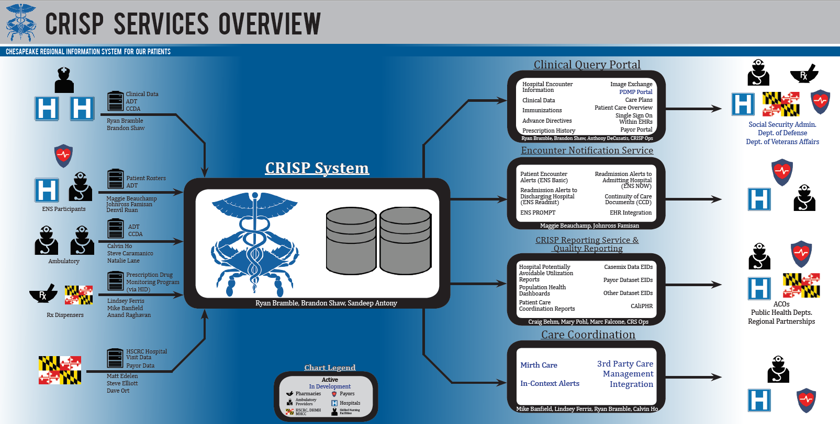

Slide 15
Marketecture Diagram
Applications
Analytics
Research
MPI
MBHE
API’s
InContextAlerts
SecureText
SalesForce
Pt Portal
Medicare
CaseMix
CCLF
SSO + Context (Unified Landing Page)
CCW
Coming Soon
Clinical Portal
PDMP
PROMPT
DIRECT
MirthCare
CRS Portal
ADT Analytics
CRS Tableu
Basic CM
ImageExh
LDS
Infrastructure
OLAP / Reporting Replicas
Other Infrastructure
CDW
CMS Claims
Consent
ENS (replica)
CRS
CALIPHR
Smart
Router
AD / LDAP
+ 2FA
Splunk
OLTP
Rules Engine
Attribution
MPI (patient)
Mirth Connect
Mirth Results
ENS
Terminology
MDM Provider
Data Sources & Connectivity
ADT
ORU(coded)
MDM (text)
CCDA
PDMP
X12
CMS Claims
Attribution
Images
MDS3
Verato
EMR Vendors Onboarded / Gateways (In Production)
EMR Vendors Onboarded / Gateways (Under Development)

Slide 16
Healthcare Provider Directory
LEGEND:
#xx
= Tags match the RFP requirements section
#10
#11
#12
#20
#13
#14
Data
Consumers
APIs
Patient
Admin
Provider
Reporting
Routing
HPD+
Other HIEs, HISPs
Future Use Case
#1
Patient
Future Use Case
SalesForce
CRISP’s CRM
Relationships
#7
#5
#6
#15
#16
SSO / RBAC
#18
#19
Provider
Practitioner
Provider
Organization
Health Plan
Terminology
Use Case #1
#17
#2
#3
#4
#9
#8
Data
Sources
HL7 2.x
ADT,ORU,MDM
HL7 CCDA
MD
CaseMix
CCLF
MDS3
X12
837(I,P),834,835
3rd Party
NPPES, CAHQ, etc
HPD+
Other HIEs, HISPs
(Update volume
and frequency)
(500k-1MM/day)
(100k/day)
(All Hospital
admits/month)
(1MM member
updates /month)
(10k/day)
(All Ambulatory
visits/day)
(All MD Providers
/month?)
(All DirectTrust
Members/wkly?)
Notes:
Terms:
MR - Mirth Results, CRISP’s clinical data repository
ENS - Encounter Notification Service – Sends Notifications to providers when an attributed patient is admitted to a hospital.
IBM - IBM’s Initiate System, CRISP’s Master Person Index
Router - Custom Software responsible for some elements of routing data, and patient attribution. Relatively new, strategically intended to be responsible for all patient attribution.
CRS - CRISP Reporting Services. Tableau reports that combine information from multiple sources.
Optum Feed - Third Party services that receives information from insurance providers, normalizes, and shares the data with CRISP.

Slide 18
Questions?
Contact Seth Sacher
Seth.Sacher@crisphealth.org
201-286-7127

